Slide 1
Fashion Consultant Project
By Lenani McFarland, Priya Limbachiya, & Jessica Graca

Slide 2
THE CLIENT
NAME: Jessica Graca
ADDRESS: 358 W 45th
CELL PHONE: 516-492-9451
EMAIL: jessgracabusiness@gmail.com
BEST WAY AND TIME TO CONTACT YOU: Email, weekdays
CAREER / JOB TITLE / COMPANY : Lead singer of rock band
HEIGHT : 5'3 | WEIGHT : 114 | HAIR COLOR : Two-tone (dark brown and blonde) | HAIR STYLE : Below shoulder / wavy | EYE COLOR: Dark brown JACKET / SUIT : M-L | TOP / BLOUSE : XS - XL | OUTERWEAR : M-L | SKIRT / PANT: XS-XL | DRESS: XS - S | SHOES 6.5 / 7 US Womens

Slide 3
QUESTIONNAIRE
STYLE DESCRIPTION: Cutting edge / oversized / archive / streetwear / alternative
WHICH DESIGNERS / BRANDS / STORES DO YOU LIKE & SHOP IN : Rick Owens / Hyein Seo / Dion Lee / Heliot Emil / Julia Silver
WHICH COLORS DO YOU MOSTLY WEAR? Neutrals and blacks
WHAT IS YOUR LIFESTYLE? Band practices / writing music / recording / concerts / events
HOW DO YOU ULTIMATELY WANT TO LOOK & FEEL? Client wants to look good, feel good and have people look at her wanting to be her.
WHAT DO YOU THINK IS WRONG WITH YOUR CURRENT WARDROBE AND HOW CAN WE HELP TO IMPROVE? Client is currently struggling to match the brand she’s created for herself.
BUDGET? Unlimited

Slide 4
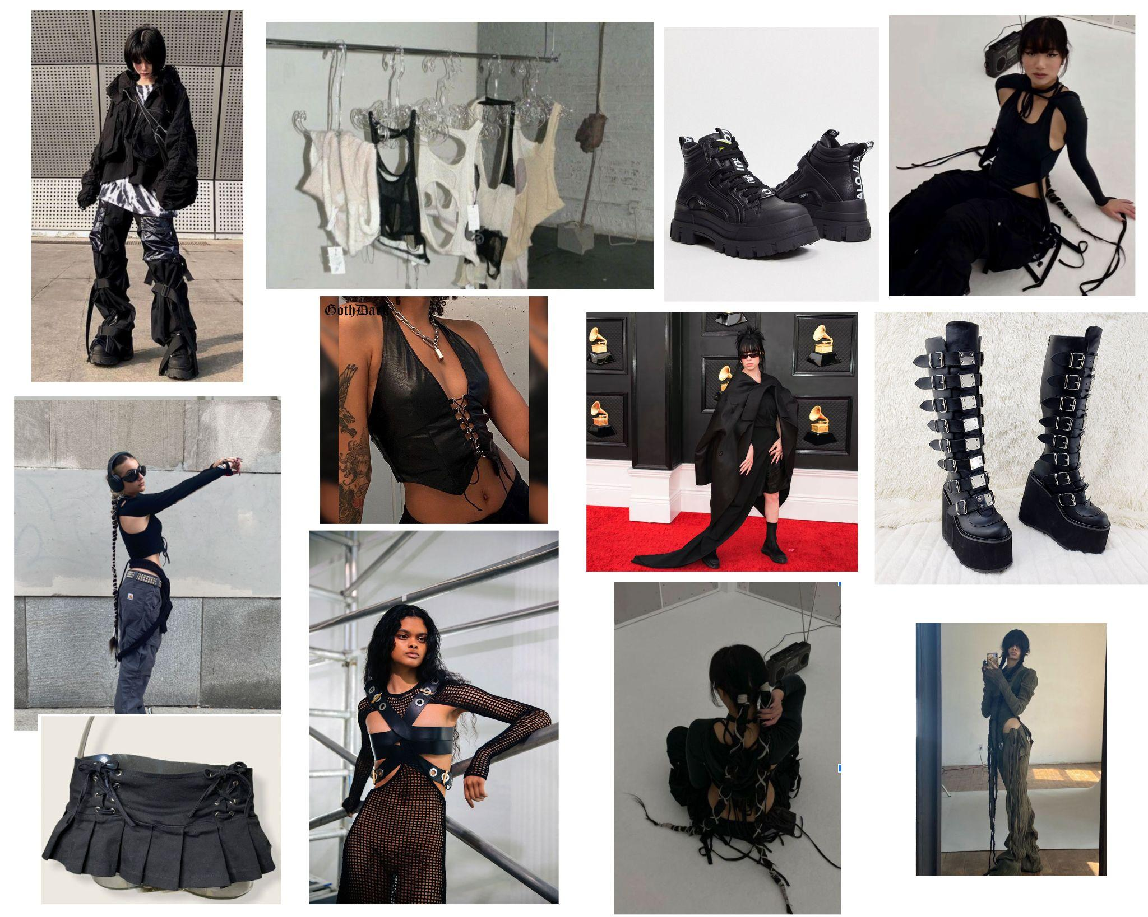
MOODBOARD

Slide 5
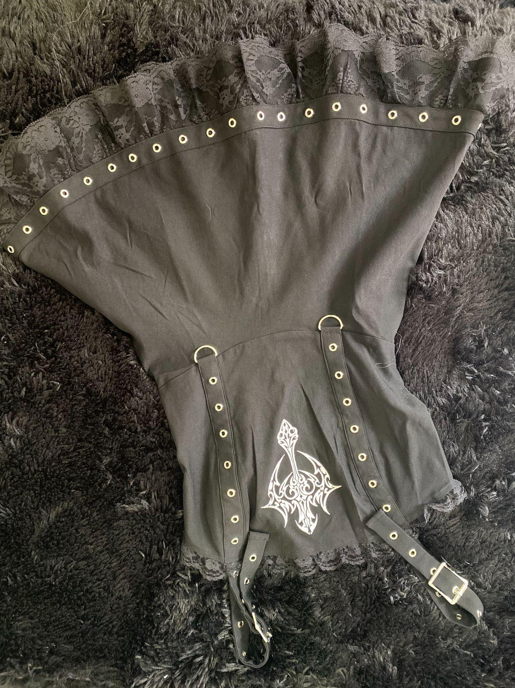
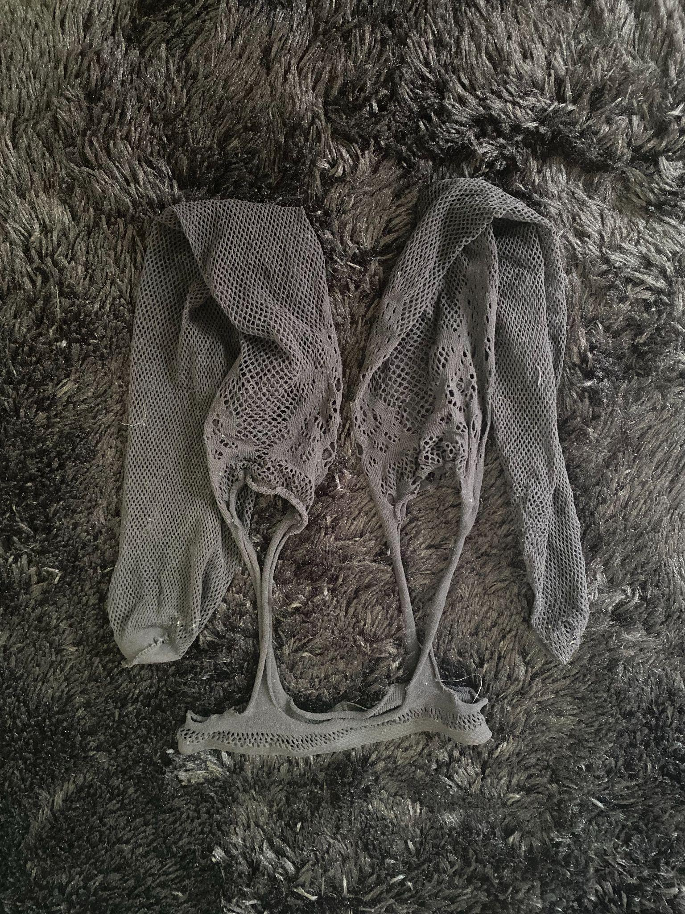
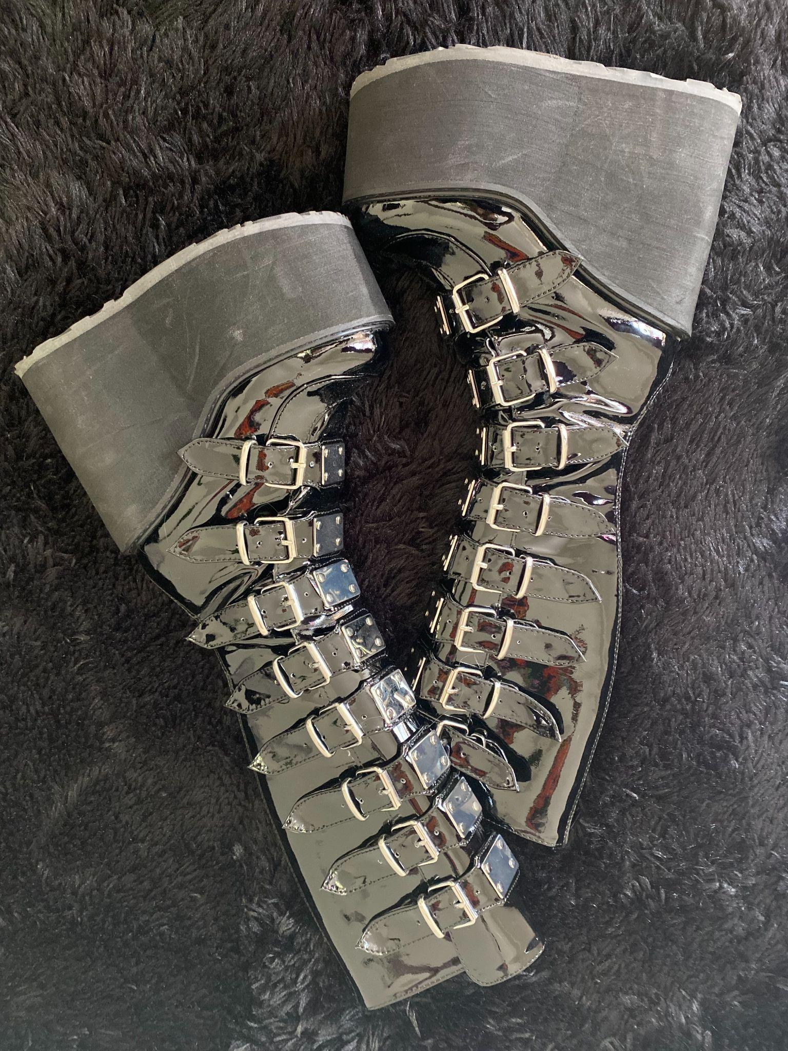
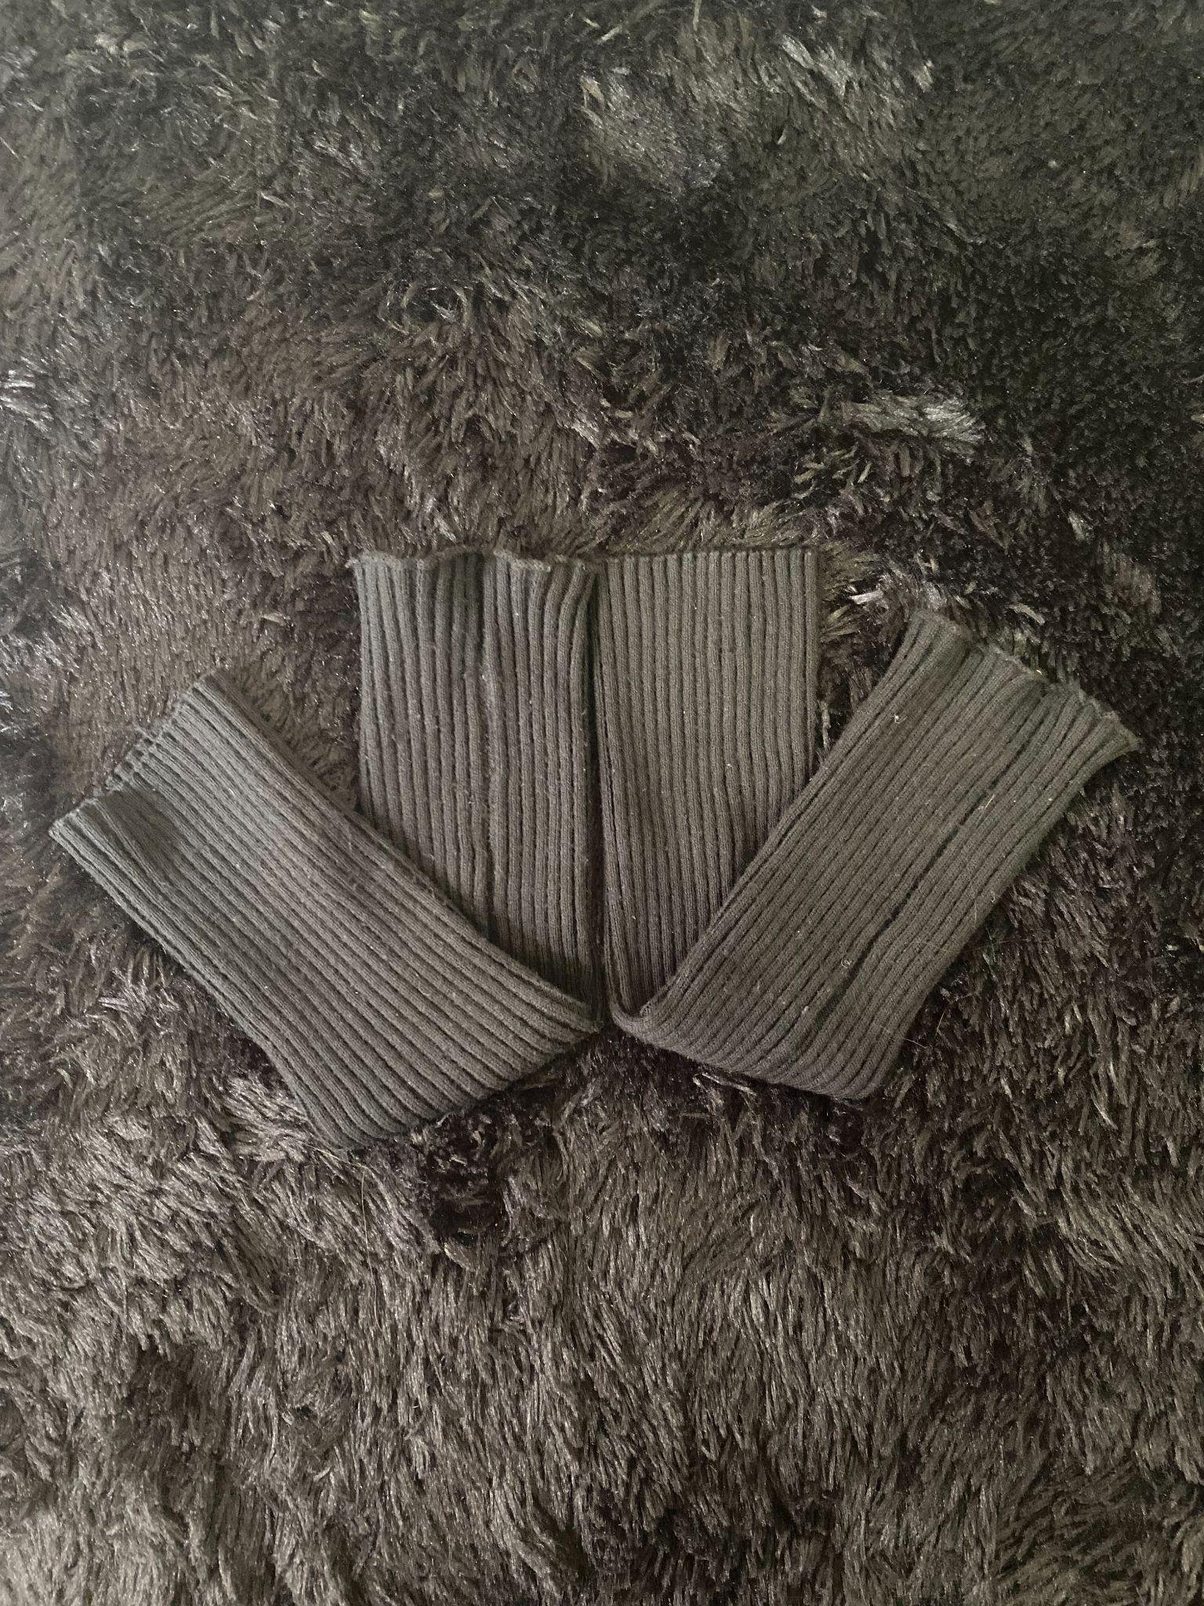
OUTFIT #1
ON-STAGE: CONCERT

Slide 6
OUTFIT #1 DETAILS
HAIR & MAKEUP
BLACK DRESS
BLACK ARM WARMERS
BLACK PLATFORM BOOTS
GARTER TIGHTS
BLACK GRAPHIC LINER
2 HIGH PONYTAIL BRAIDS WITH SAFETY PINS

Slide 7
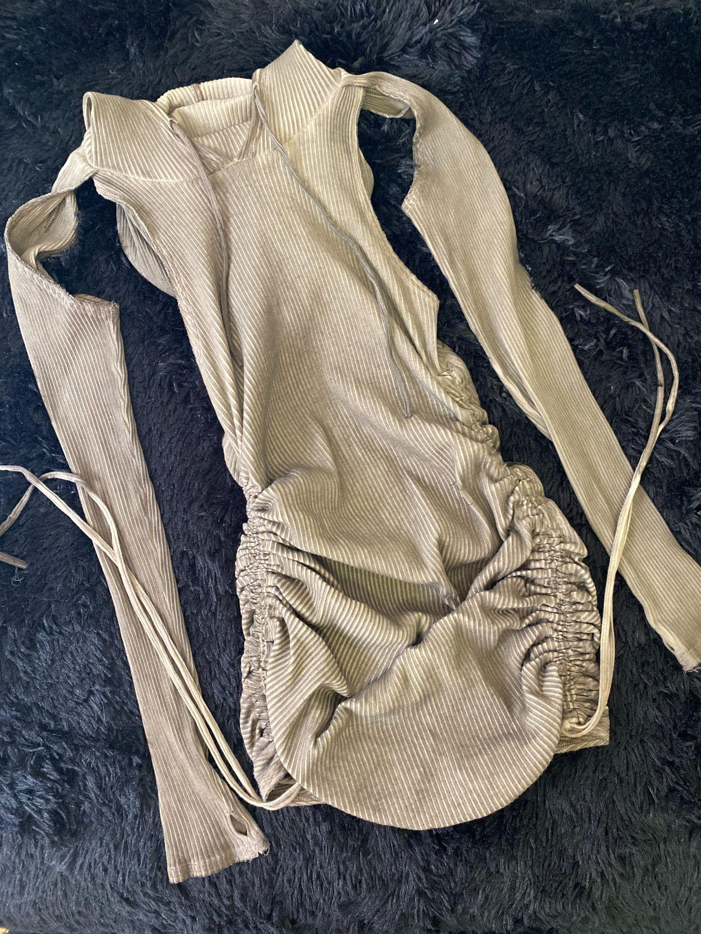
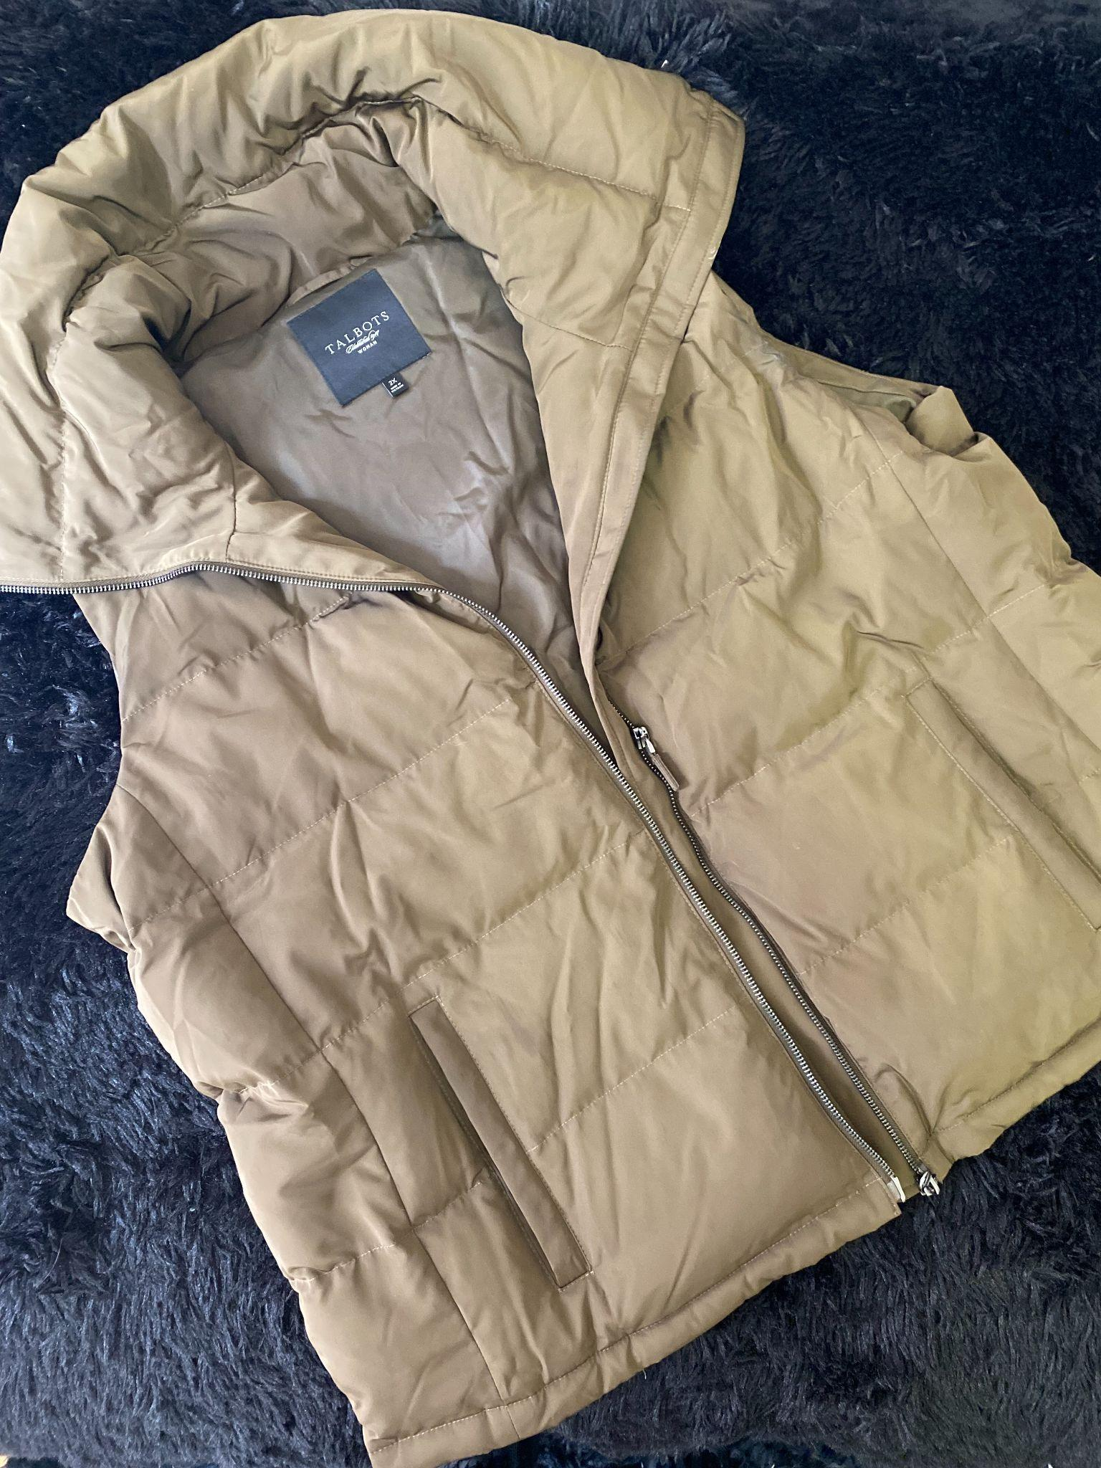
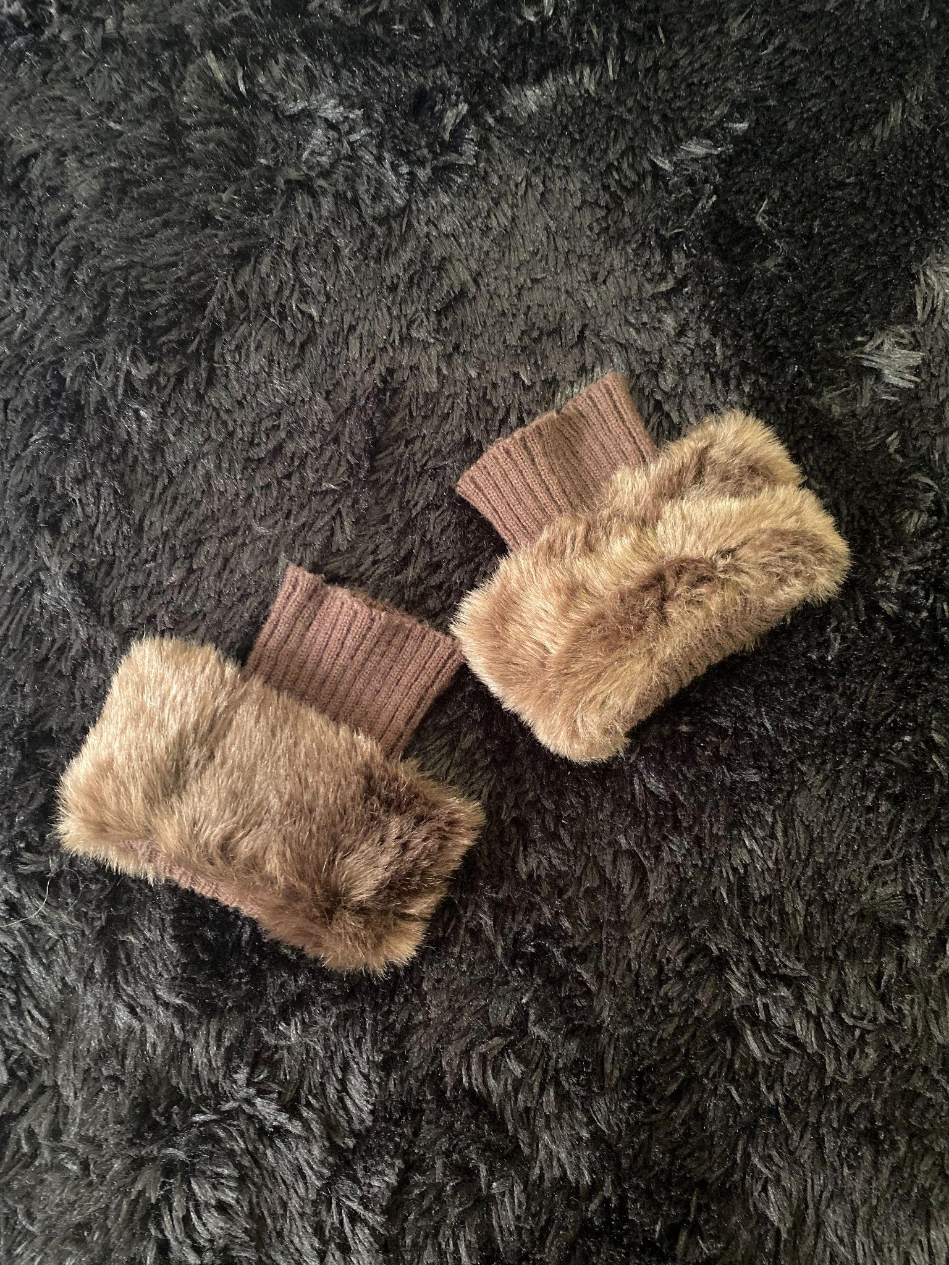
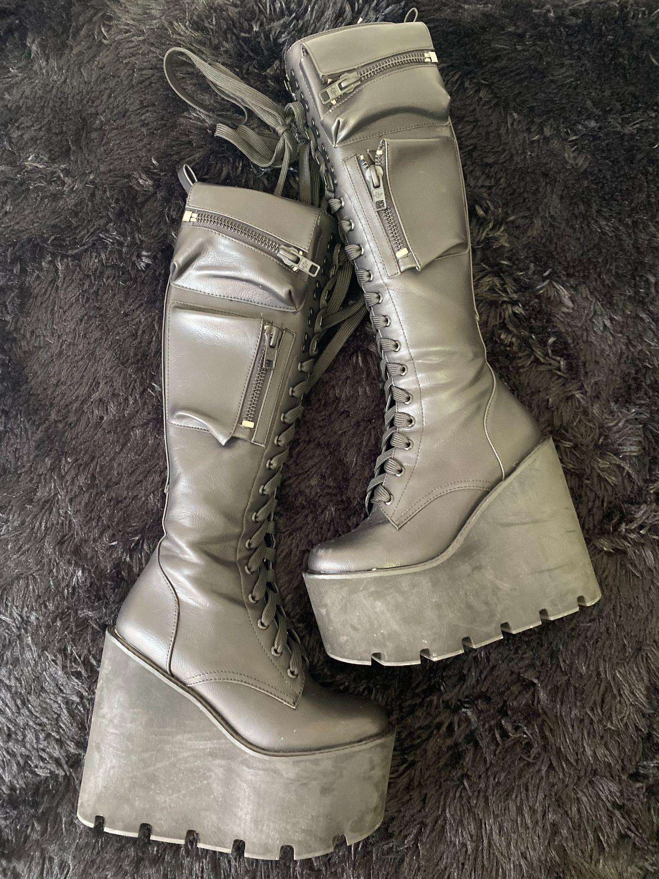
OUTFIT #2
CLUB APPEARANCE

Slide 8
OUTFIT #2 DETAILS
HAIR & MAKEUP
TAUPE RIBBED HOODED DRESS
TAUPE PUFFER VEST
BROWN FUR GLOVES
BLACK PLATFORM BOOTS
BROWN SMOKEY LINER
SLICKED BACK 2 FT. EXTENSION PONYTAIL BRAID

Slide 9
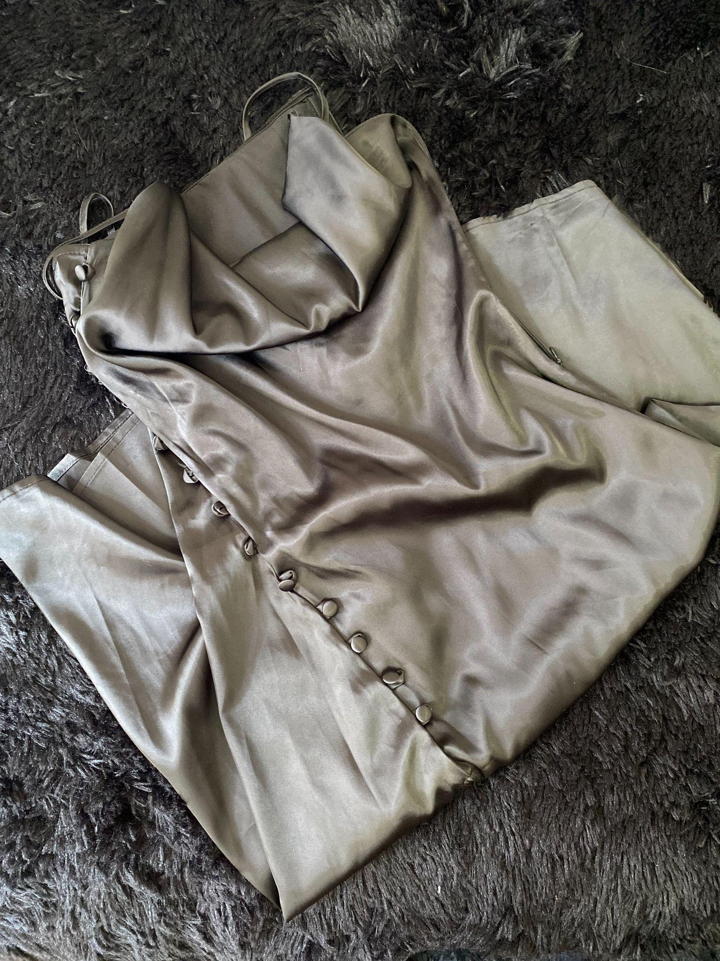
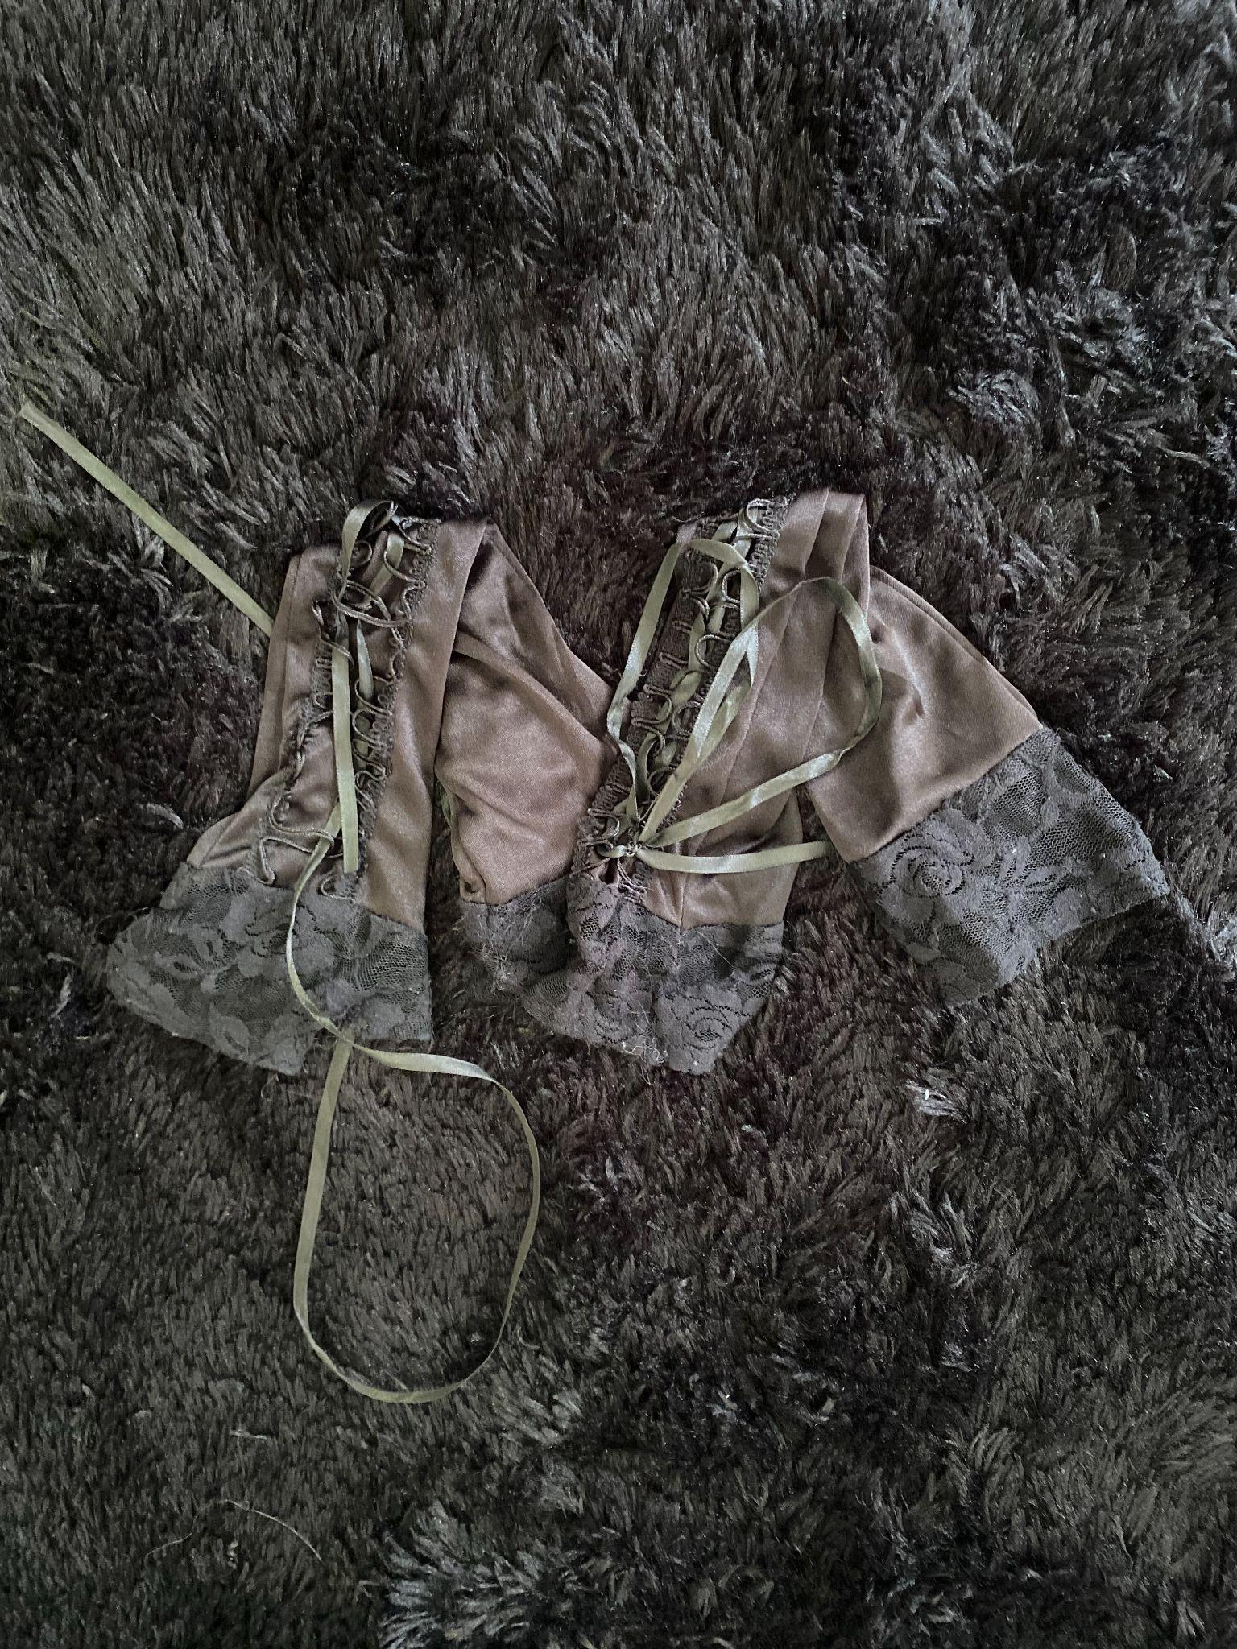
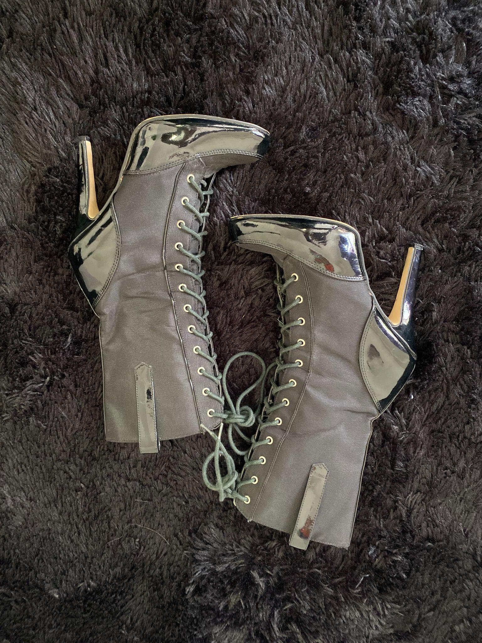
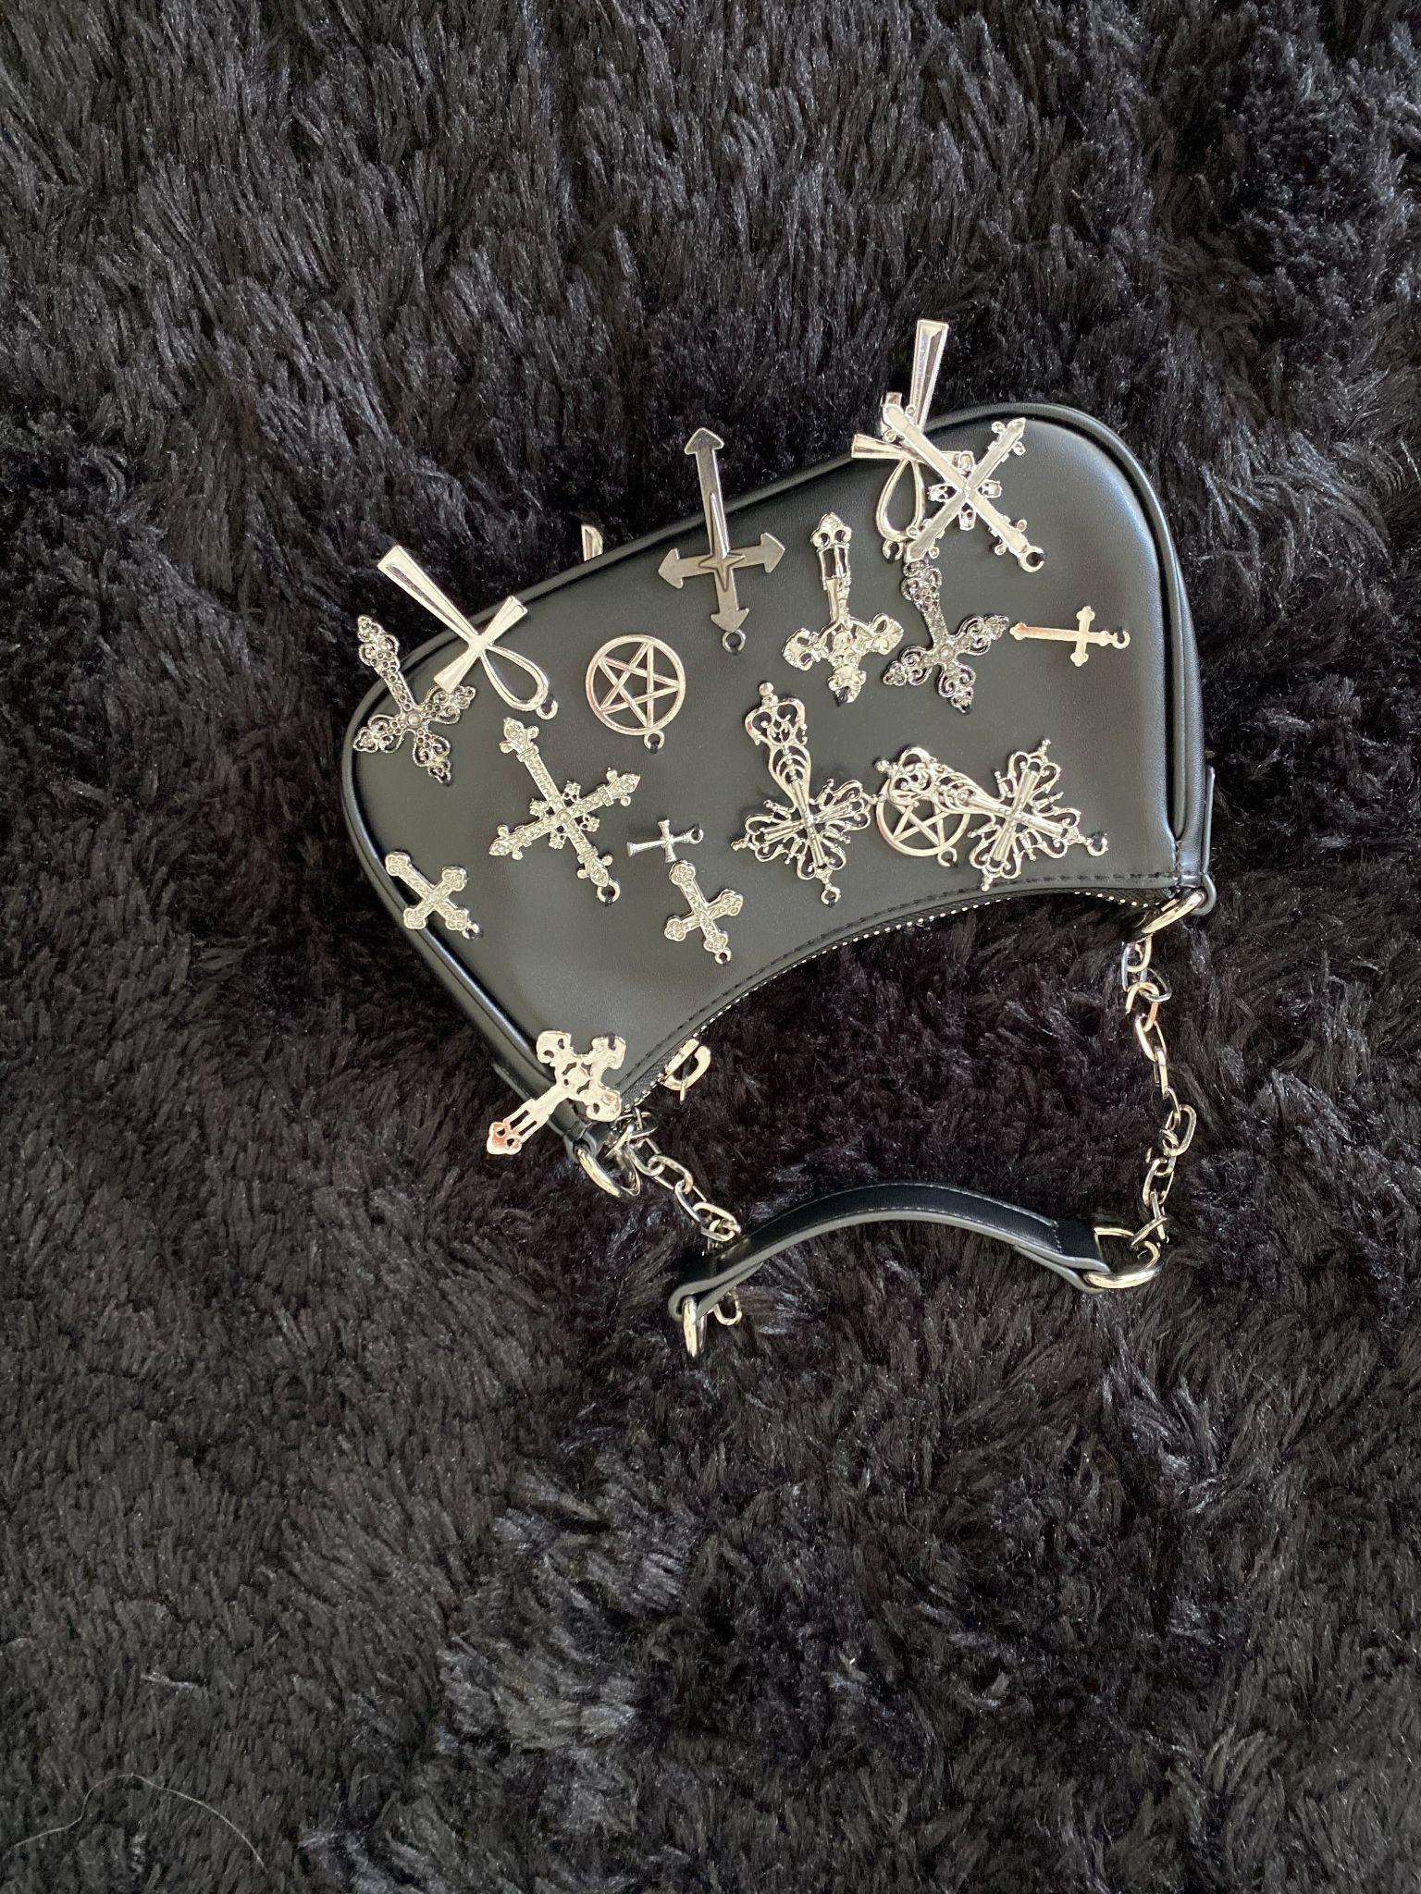
OUTFIT #3
RED CARPET EVENT

Slide 10
OUTFIT #3 DETAILS
HAIR & MAKEUP
BLACK SATIN DRESS
STILETTO BOOT HEELS
BLACK LACE GLOVES
SILVER ACCENT BELT
SILVER CHARM BLACK PURSE
SIMPLE BLACK SMOKEY LINER
BLUE CONTACTS
SLICKED BACK “WET” LOOK

Slide 11
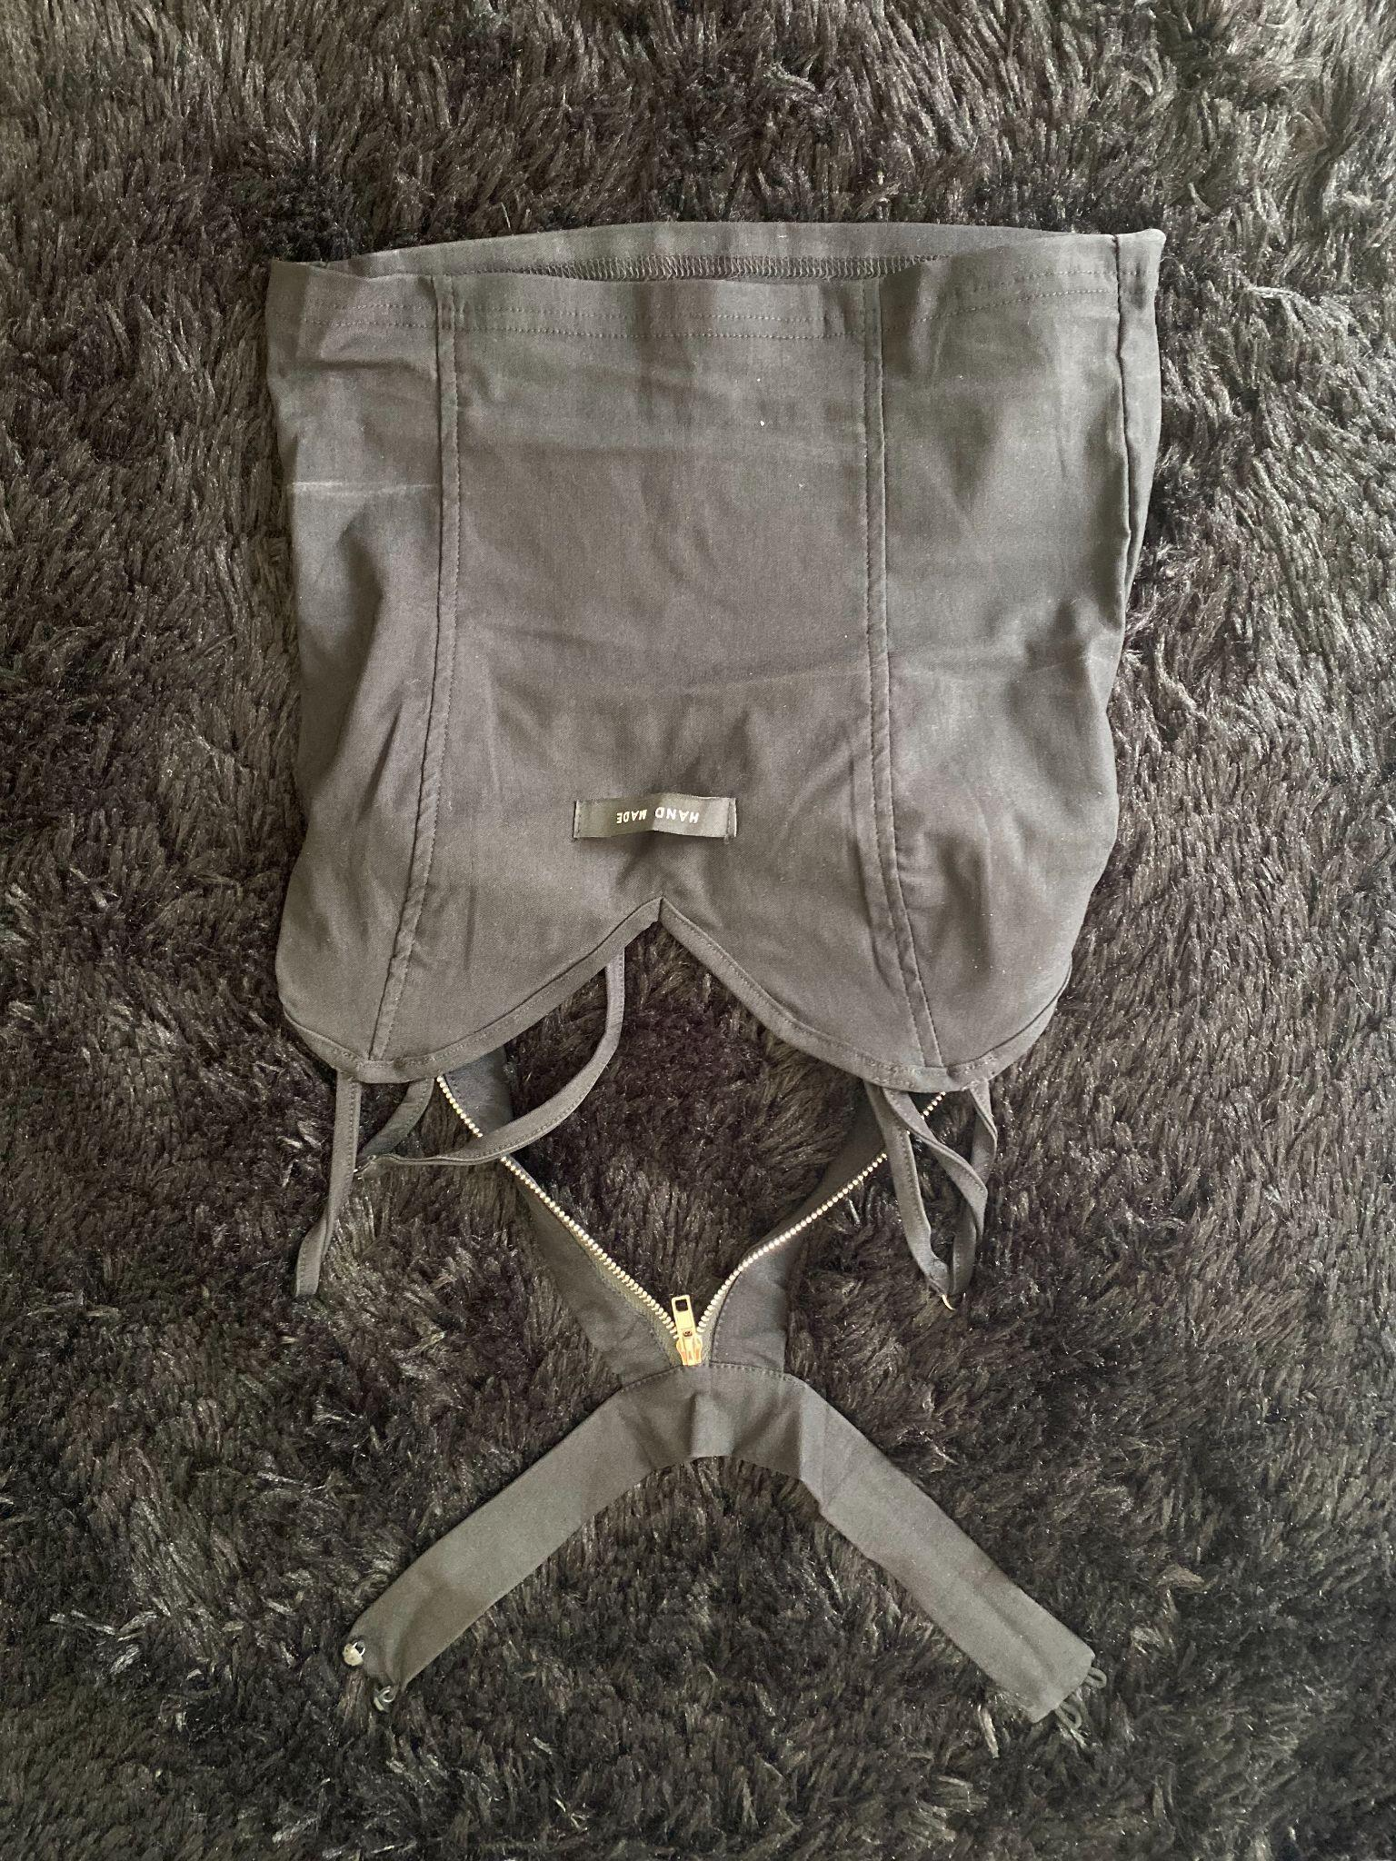
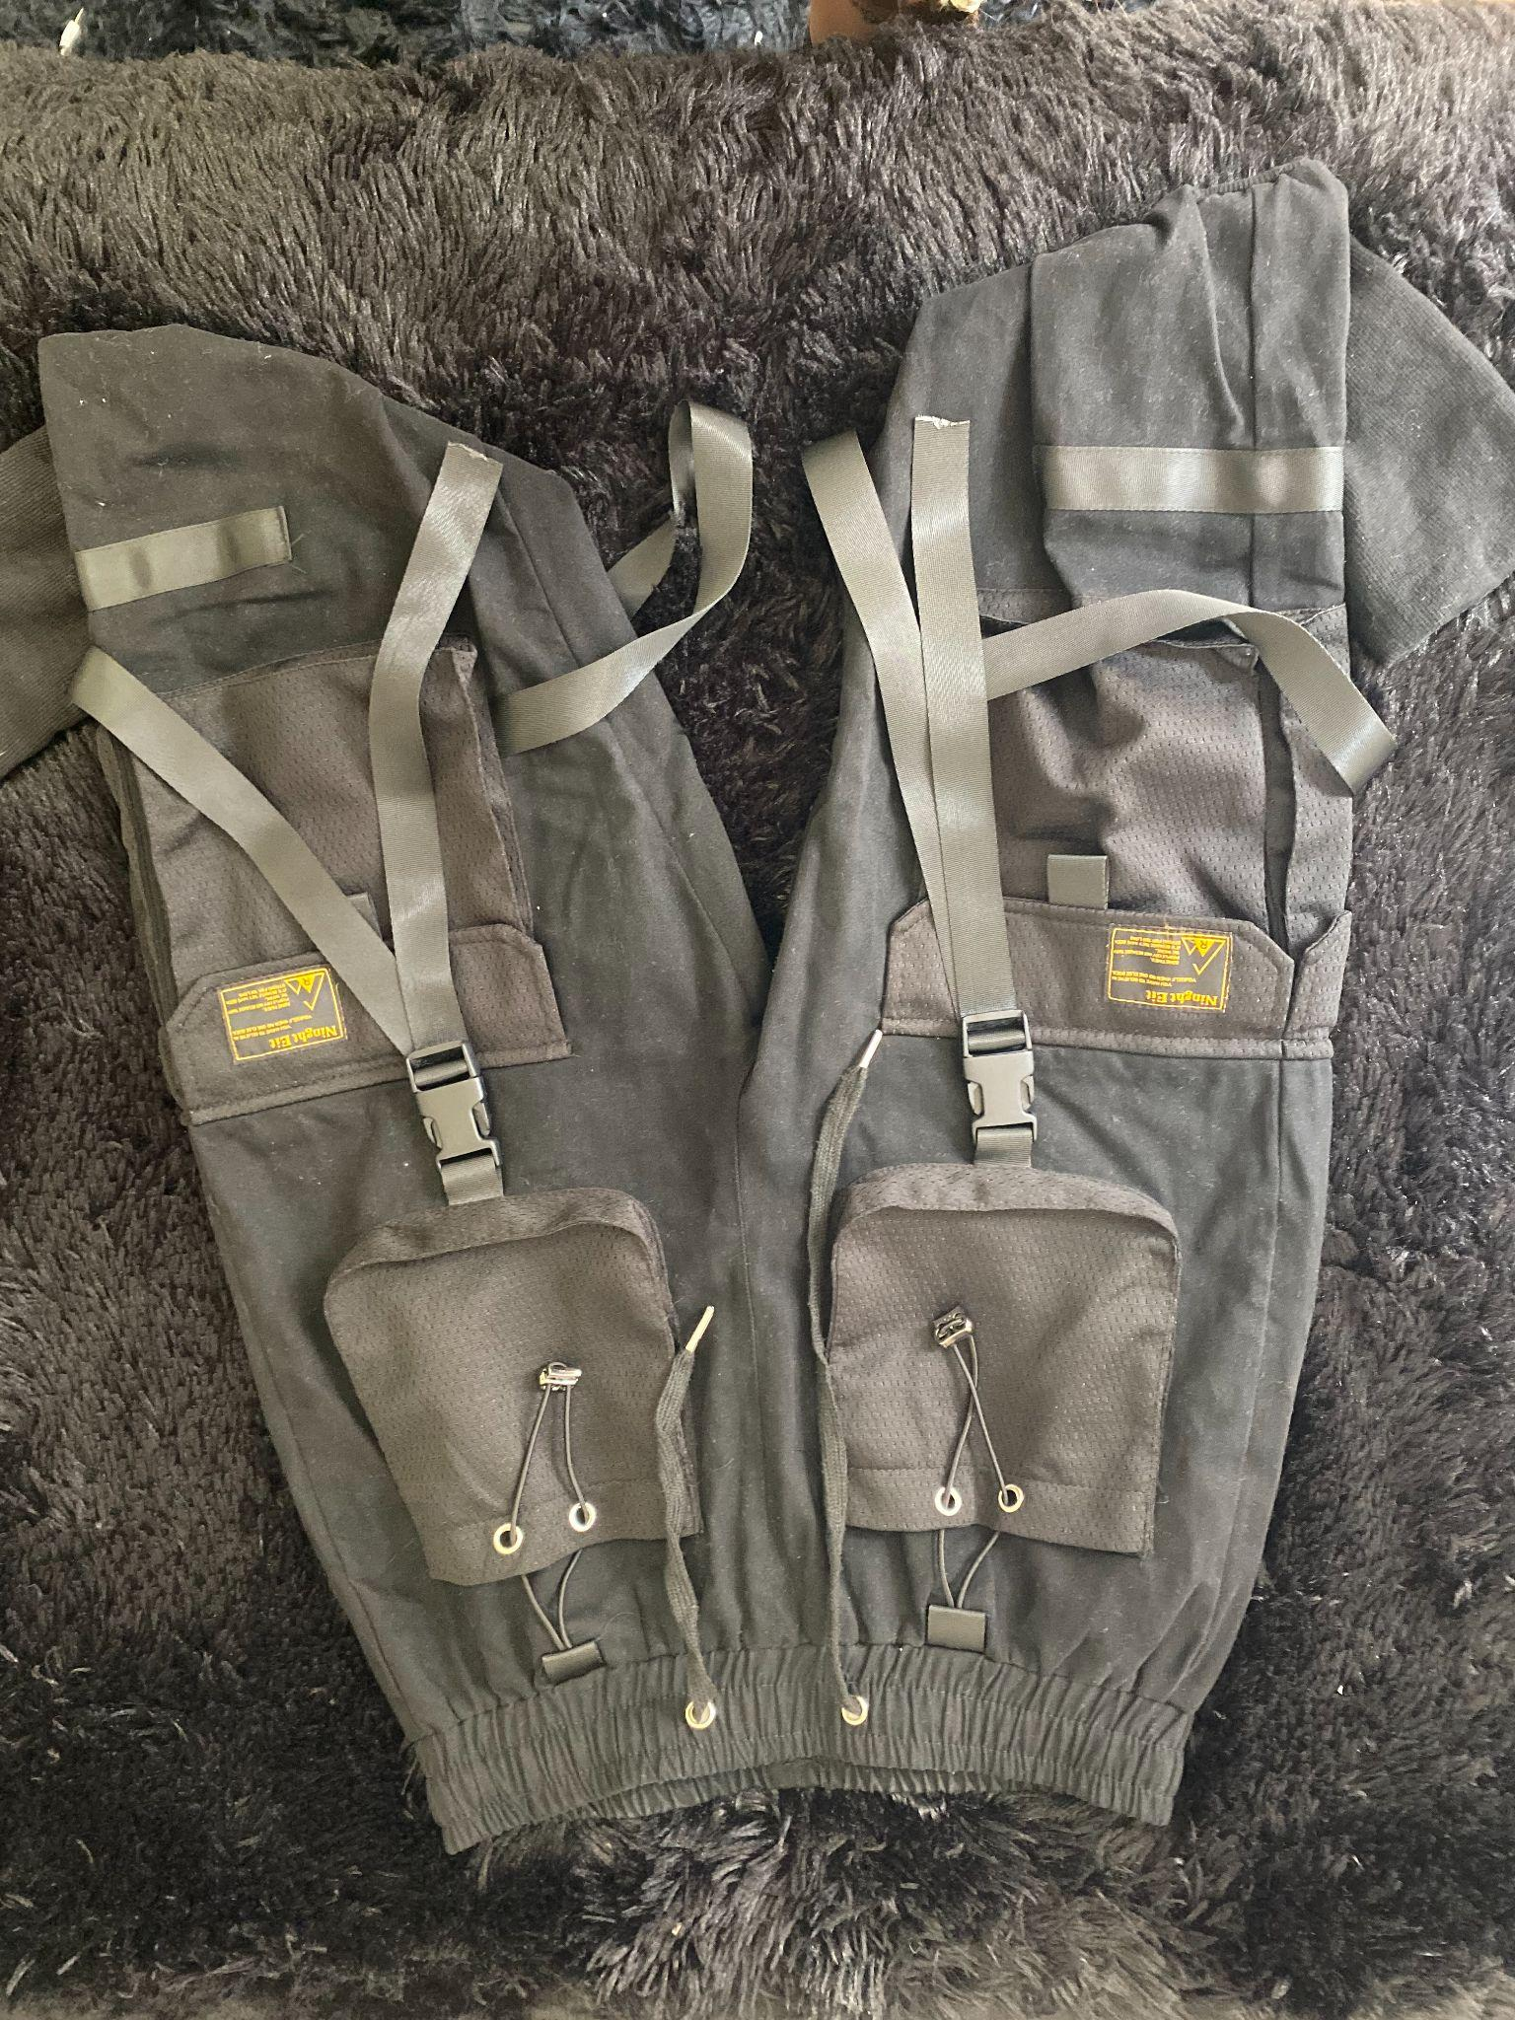
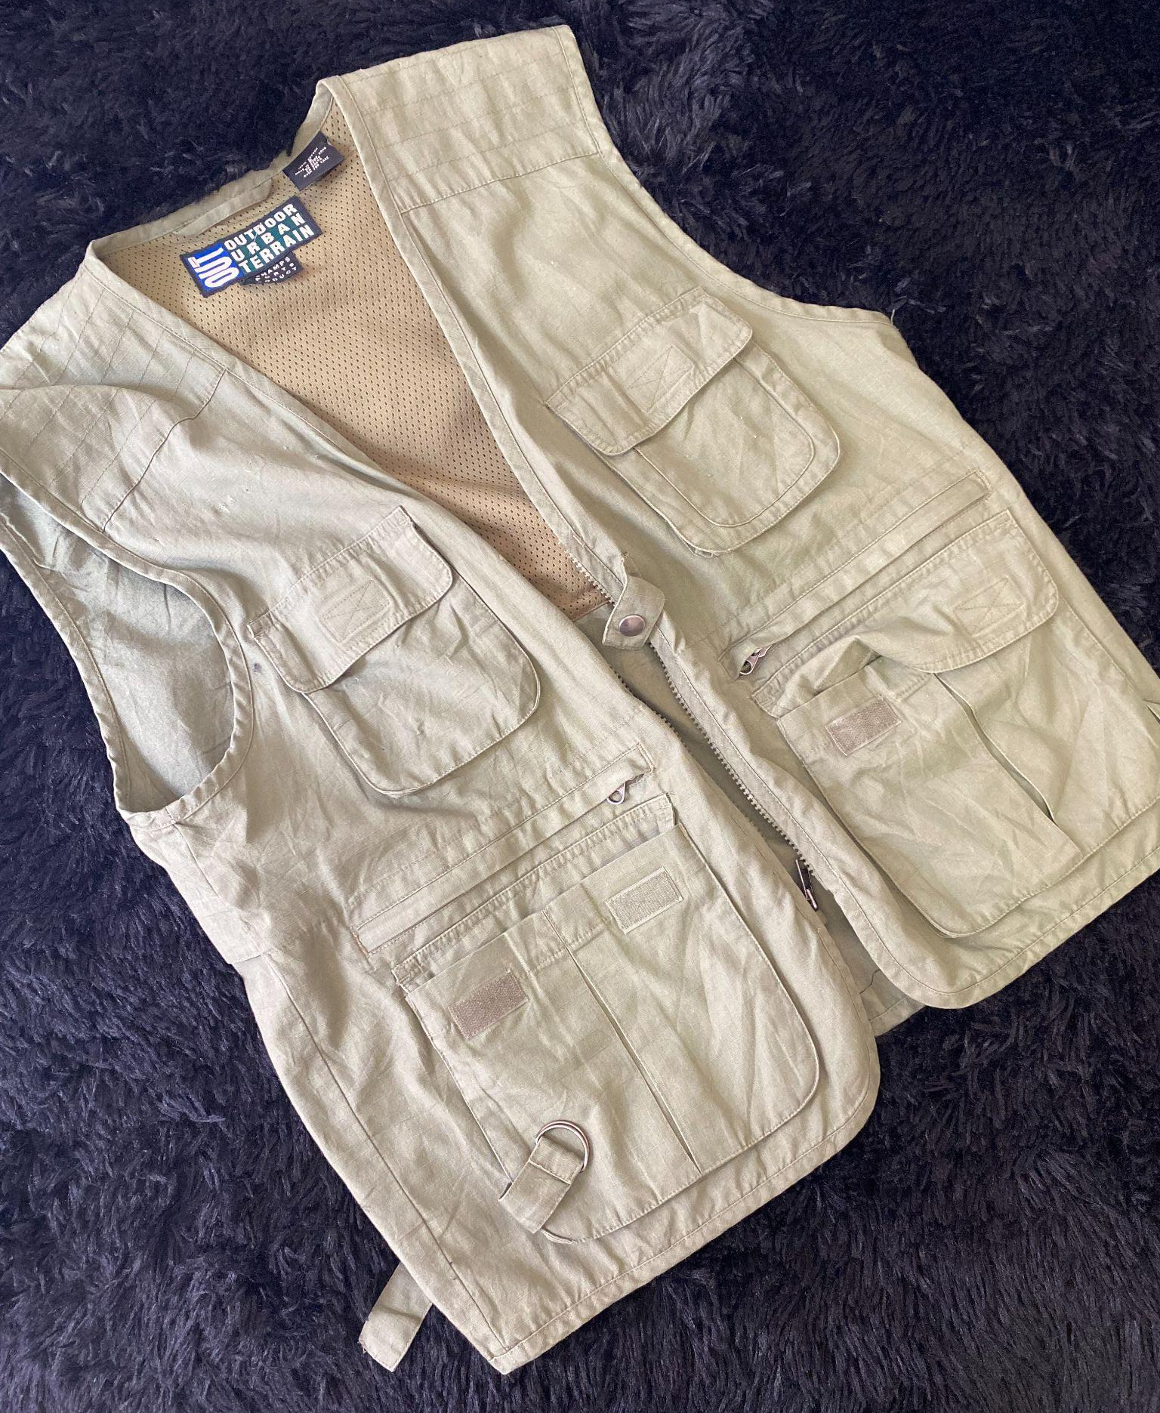
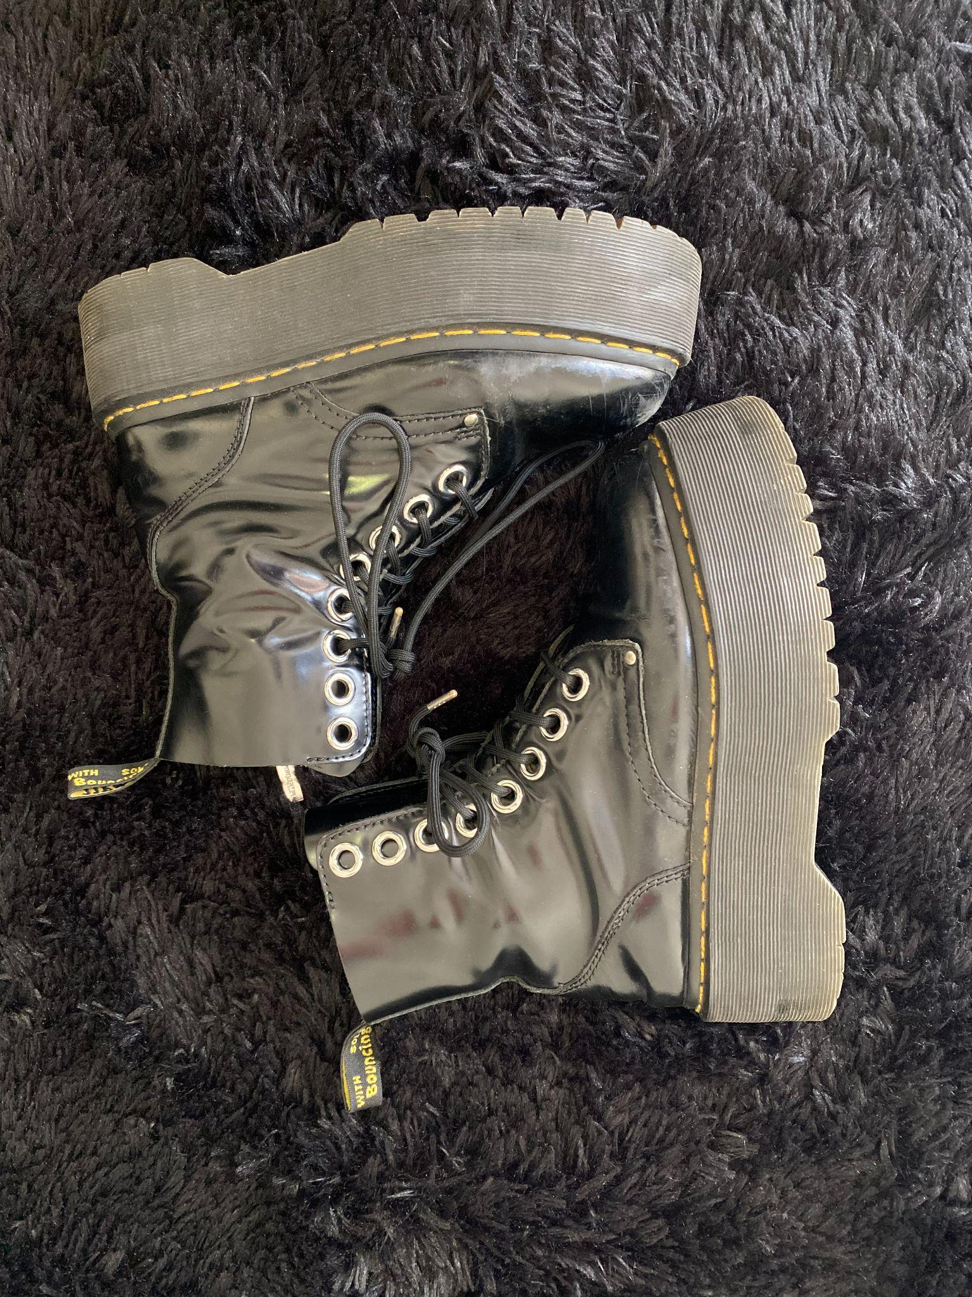
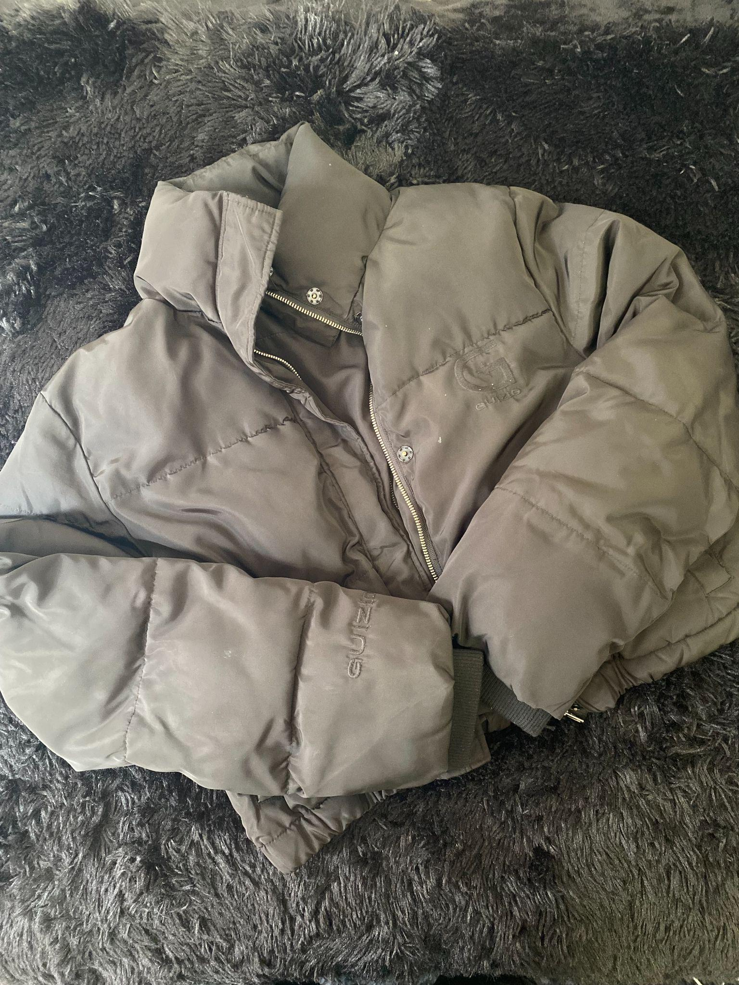
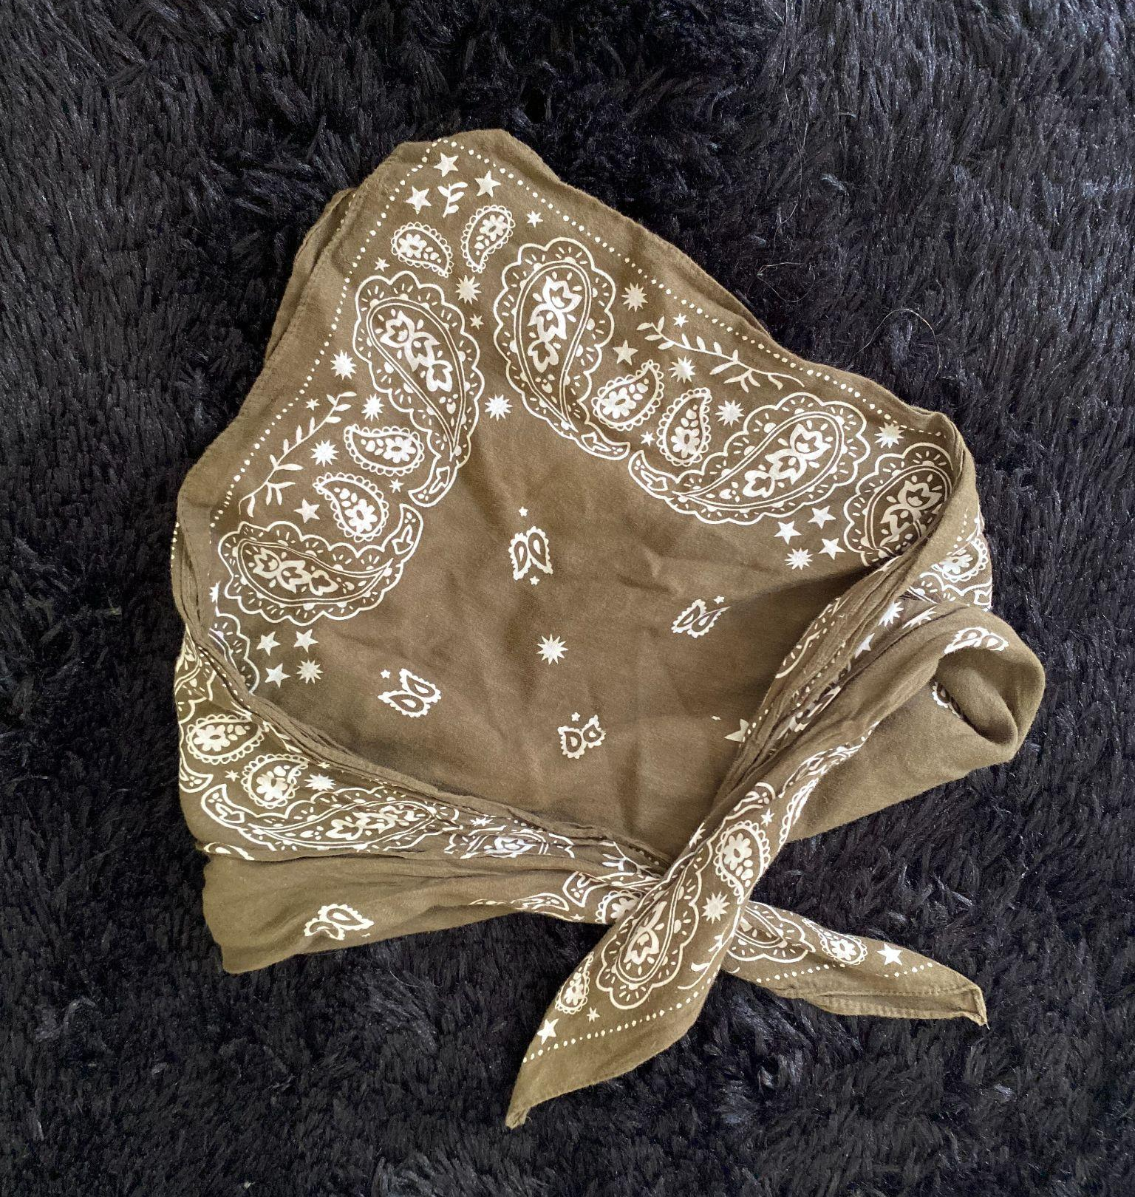
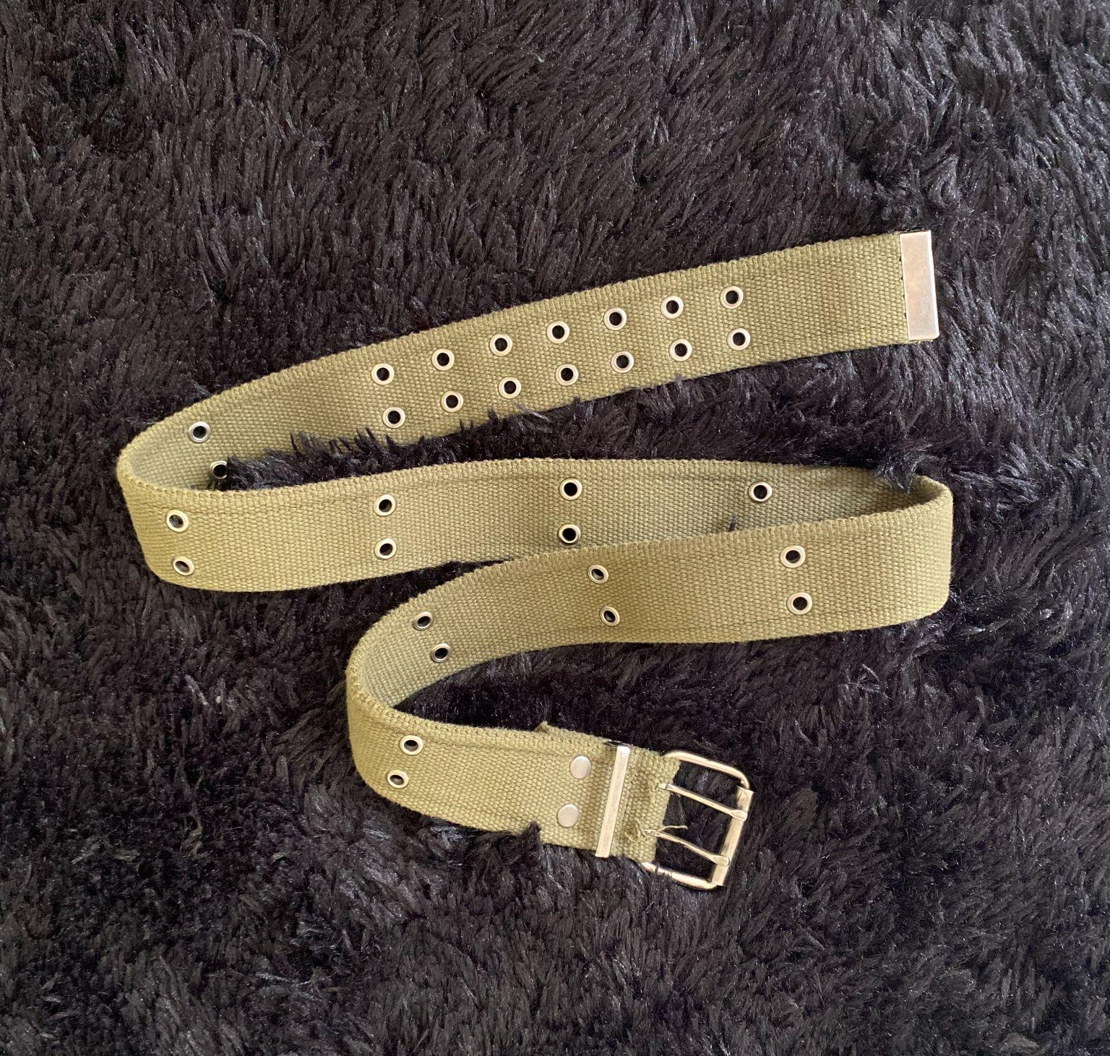
OUTFIT #4
STREETWEAR

Slide 12
OUTFIT #4 DETAILS
HAIR & MAKEUP
BLACK PUFFER JACKET
OLIVE GREEN TACTICAL VEST
BLACK ZIPPER TOP
BLACK TECH WEAR PANTS
OLIVE GREEN MILITARY BELT
BLACK PLATFORM BOOTS
NATURAL
LOOSE MID PONY WITH MONEY PIECES

Slide 13
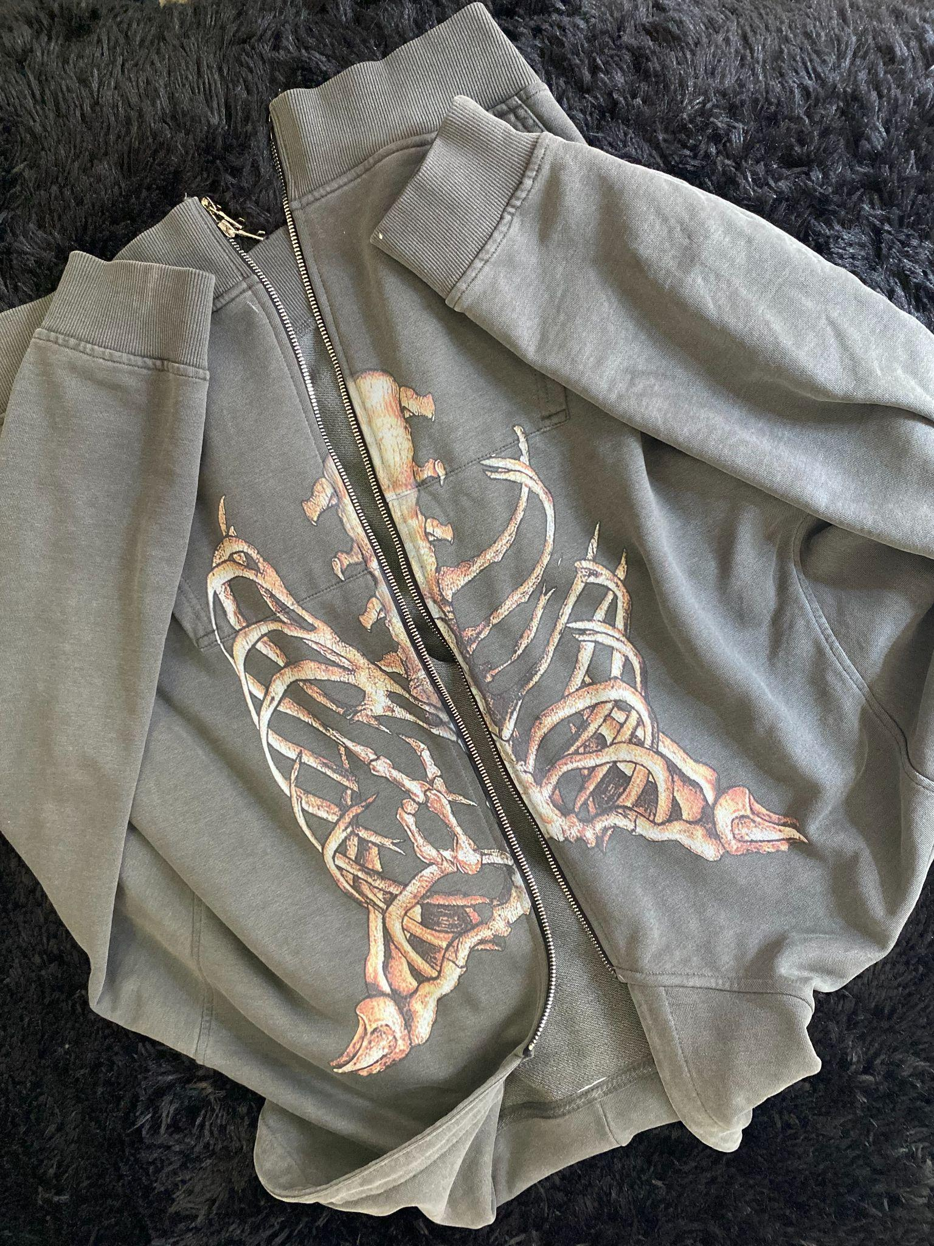
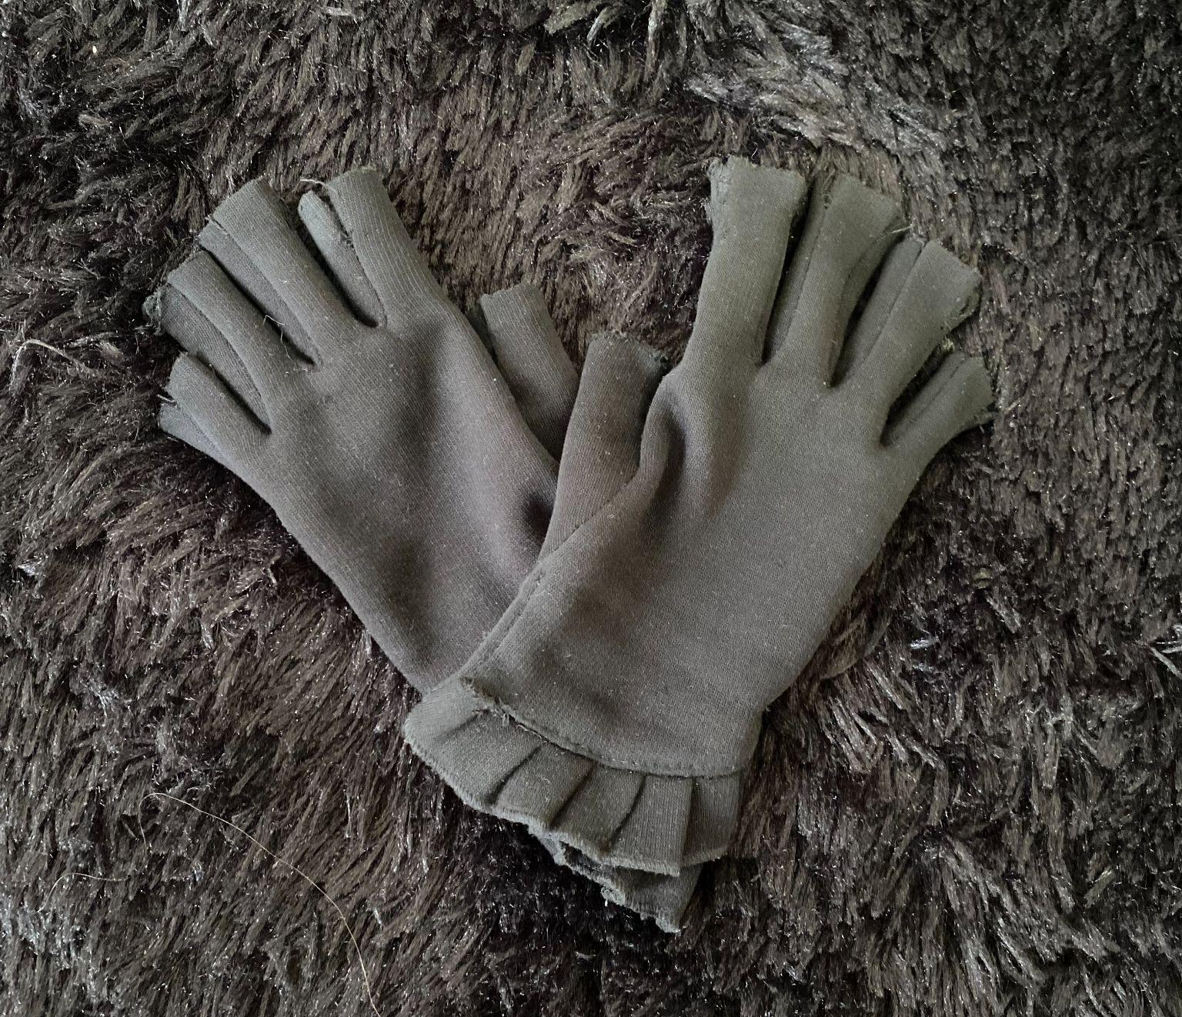
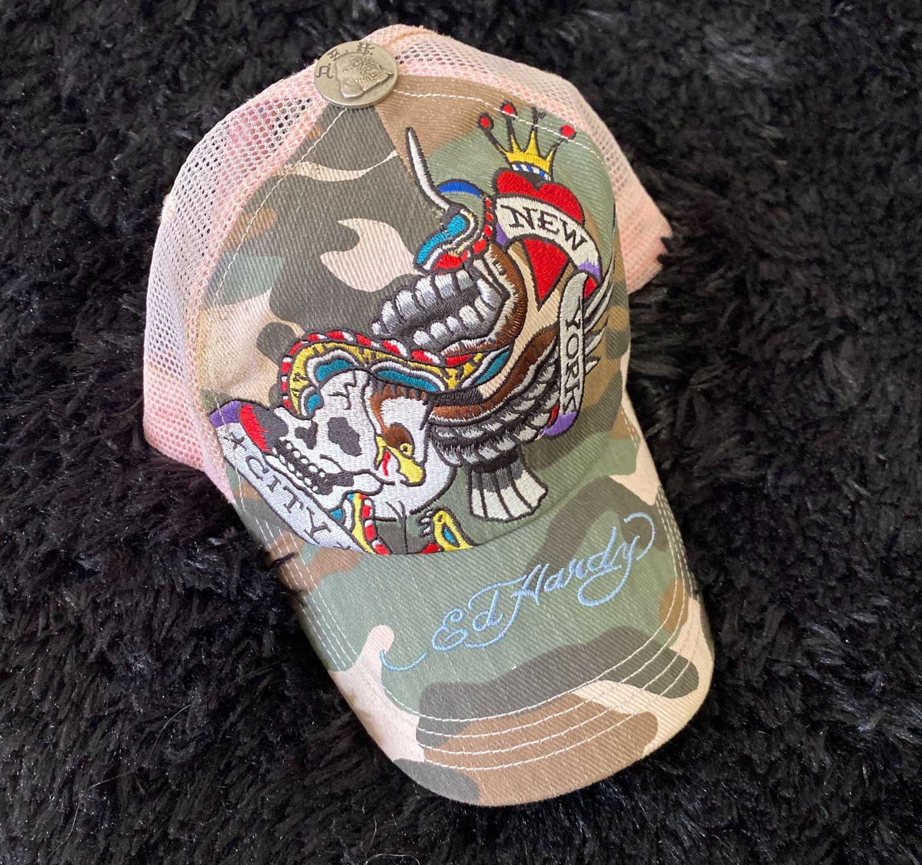
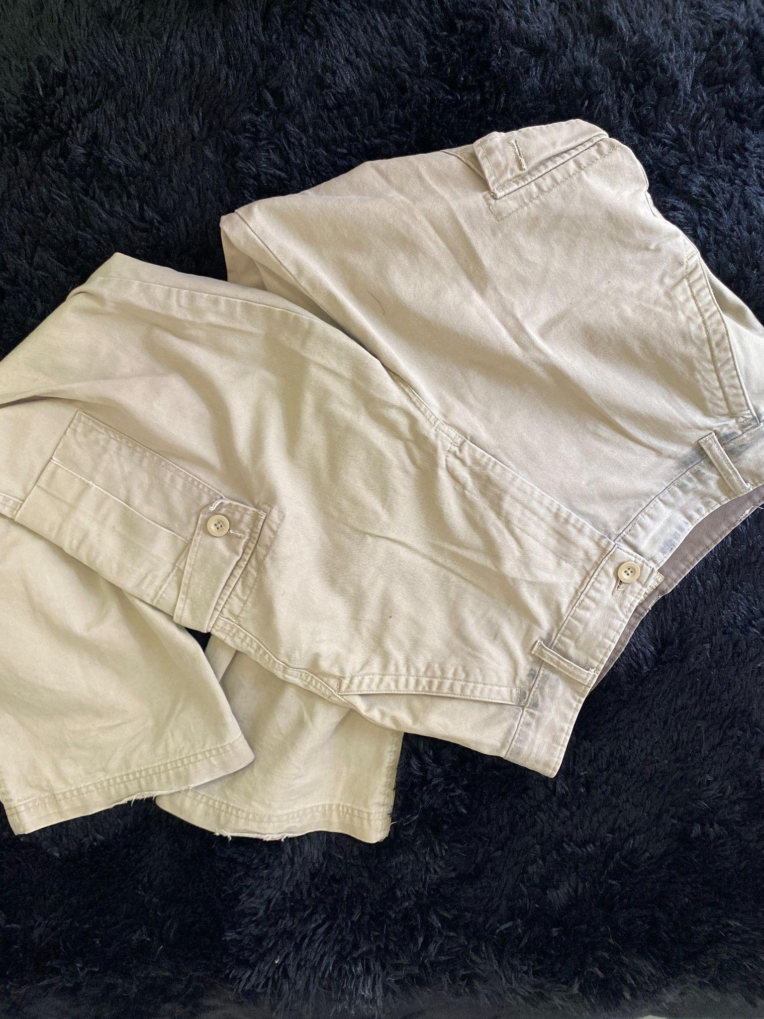
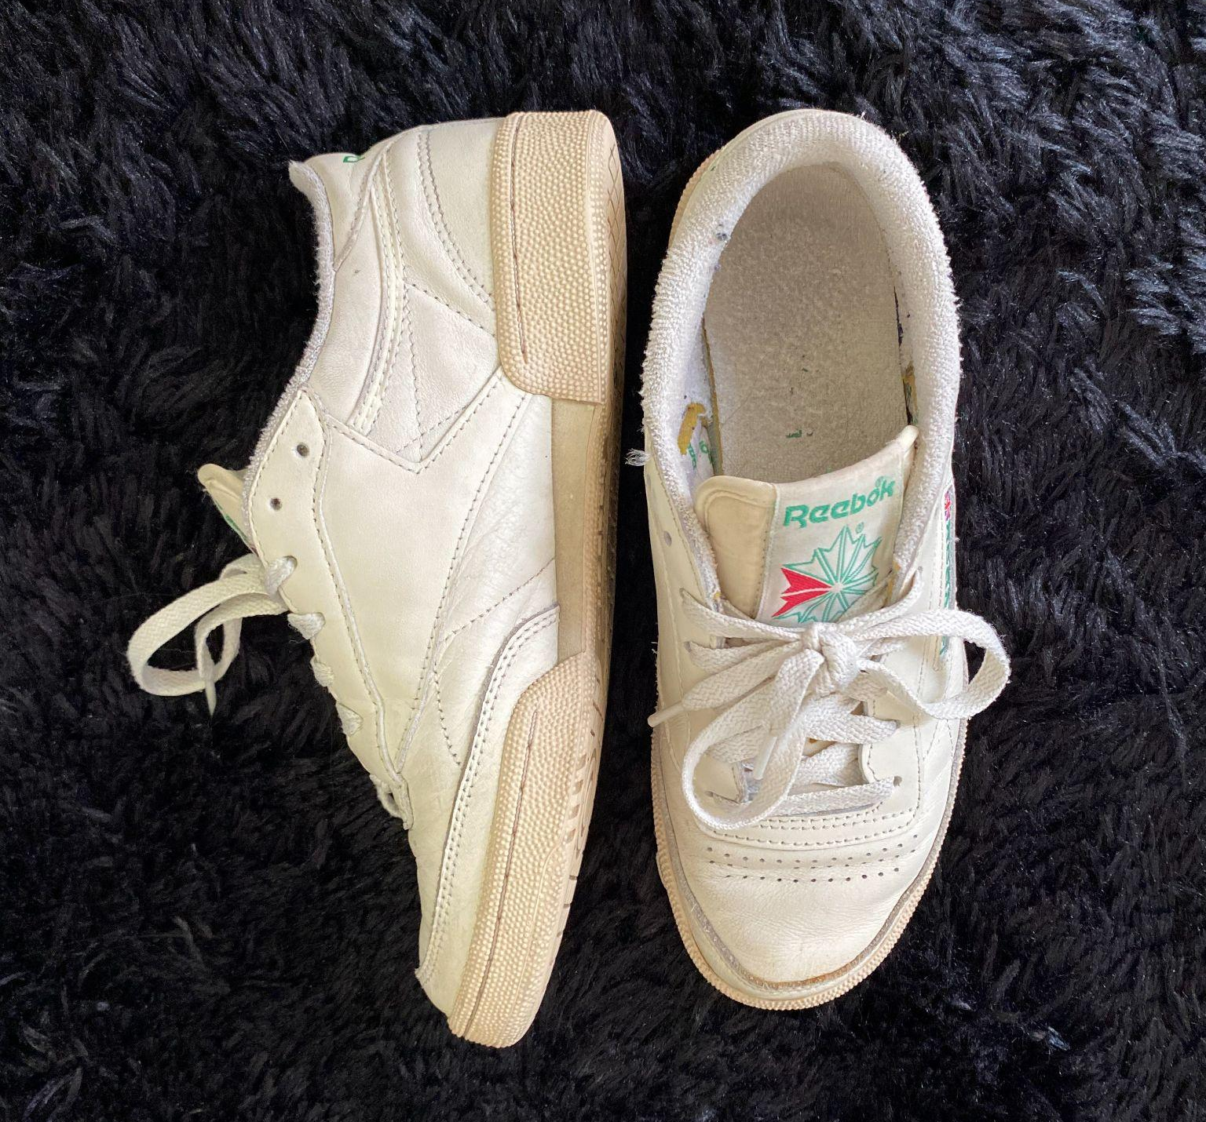
OUTFIT #5
RECORDING STUDIO

Slide 14
OUTFIT #5 DETAILS
HAIR & MAKEUP
GREY SKELETON ZIP UP
BLACK TANK TOP
BLACK STUDDED BELT
TAN CARGO PANTS
BEIGE TENNIS SHOES
ED HARDY BASEBALL CAP
BLACK FINGERLESS GLOVES
NATURAL
STRAIGHT DOWN

Slide 15
VIDEO PRESENTATION
https://youtu.be/-HmWDMh7zrc

