Slide 1
Abercrombie & Fitch
Priya Limbachiya

Slide 2
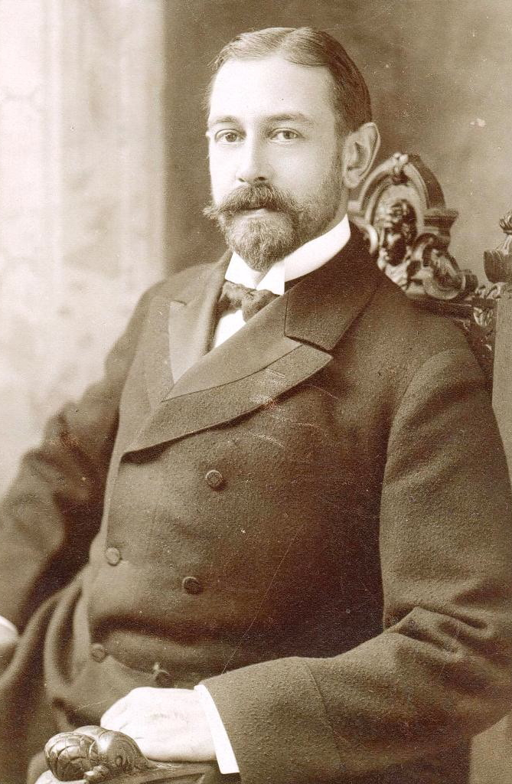
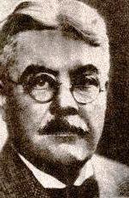
Brief History
Abercrombie & Fitch was originally founded by David Abercrombie, in 1892. Oringinally named Abercrombie and Company, the first store was opened in Manhattan. The Ezra Fitch stepped in after being a loyal client in 1908. This led to the new company name Abercombie & FItch. In the 1980s, the Limited bought the brand. In the late 1990s, the company broke off and became its own incorporation. This led to the opening of Hollister, Abercrombie Kids and Gilly Hicks.

Slide 3
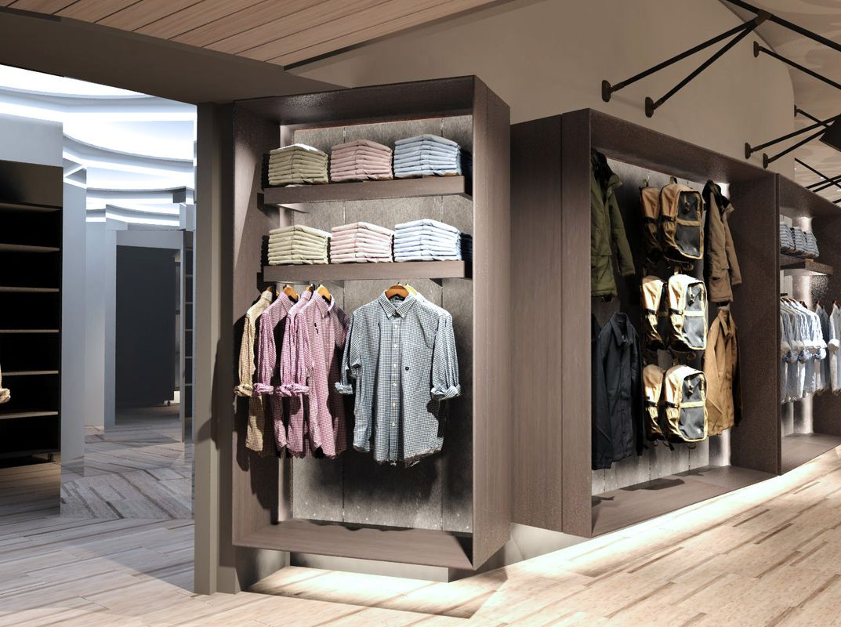
Brief Financial History
Annual Sales Volume: $1,437,600,000
Number of Stores: 859 (US & International) (2018)
Employees (All Sites): 44k
Fiscal Year End: 30-Jan-2021

Slide 4
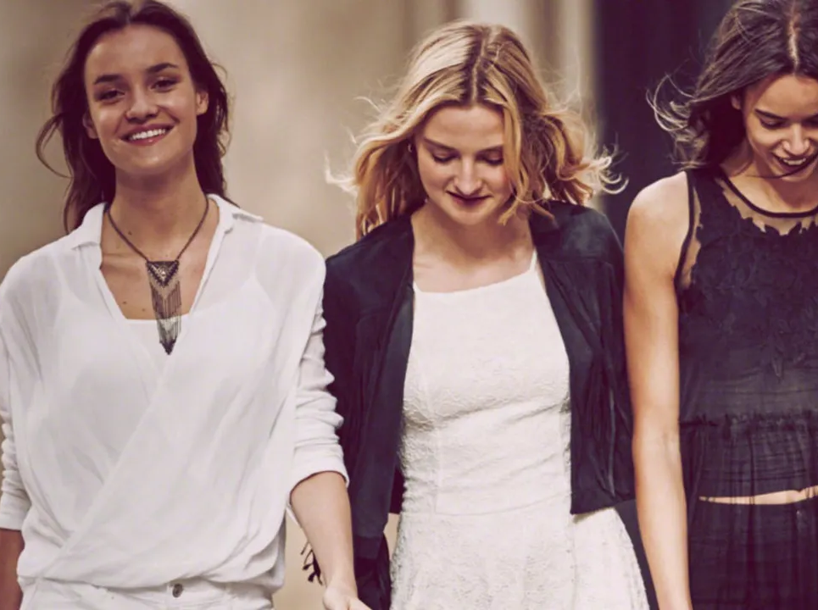
Customer Geographics, Demographics and Psychographics
Geographics
Urban and Suburban living situations
Caters to all year-round clothing cycle
Demographics
Teens and College Students
All Genders included
Ranges from Ages 15-25
Psych Demographic
Targets social class who are working
Middle Class to Upper class

Slide 5
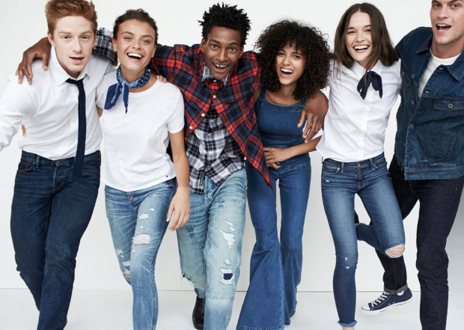
Line Concepts
“We are committed to embracing diversity and inclusion at Abercrombie & Fitch Co. Creating an inclusive atmosphere and experience for our customers and associates, across our global organization, is a top priority for our brands.”
Fran Horowitz, Chief Executive Officer

Slide 6
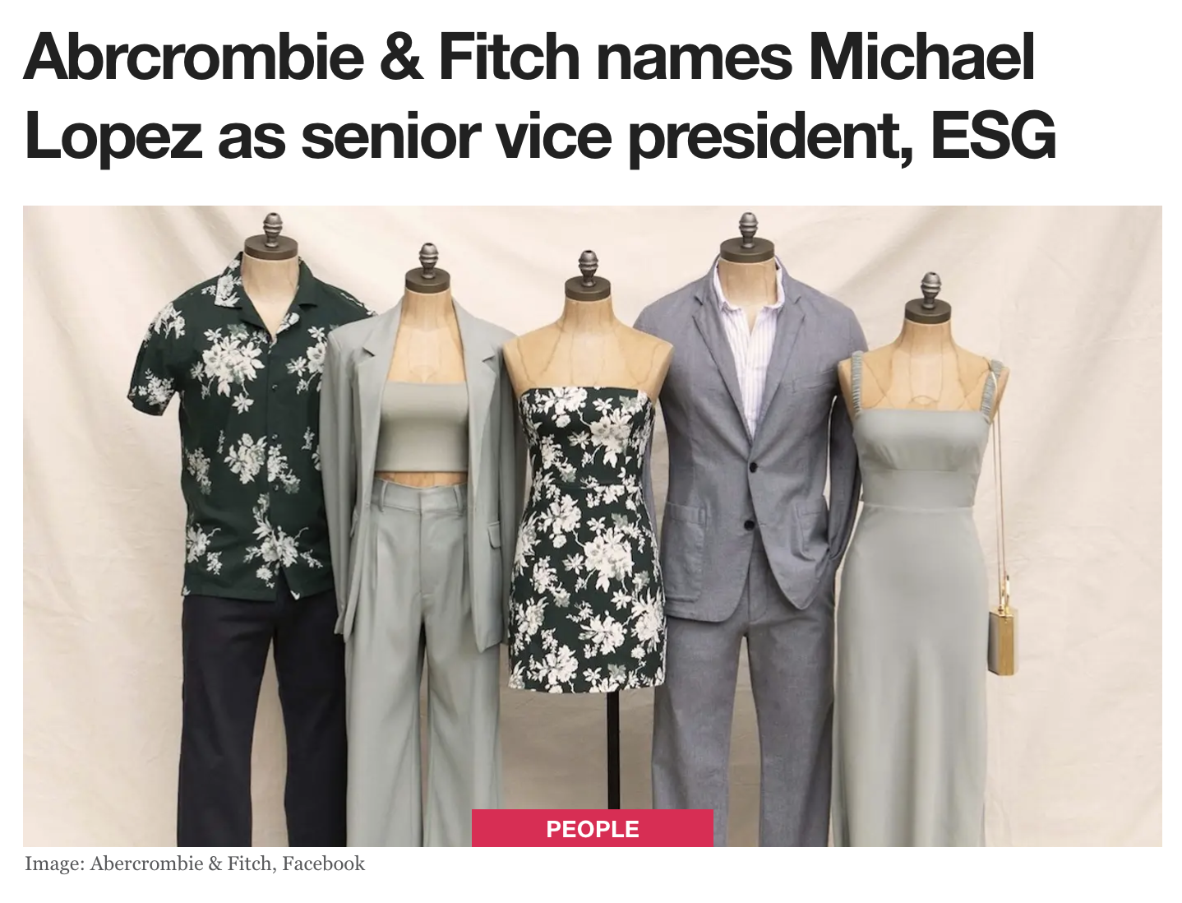
Recent News
Michael Lopez was recently announced as the new senior vice president. His new role includes "leading Abercrombie & Fitch Co.’s sustainability, community giving, and inclusion and diversity functions " (Singh paragraph 2)

Slide 7
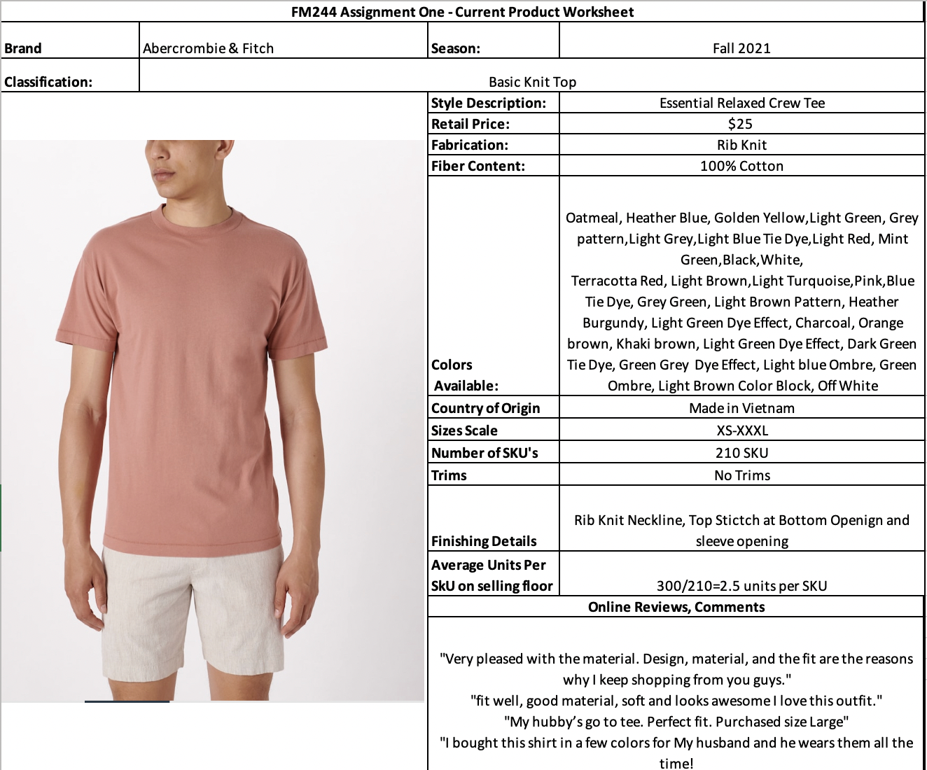

Slide 9
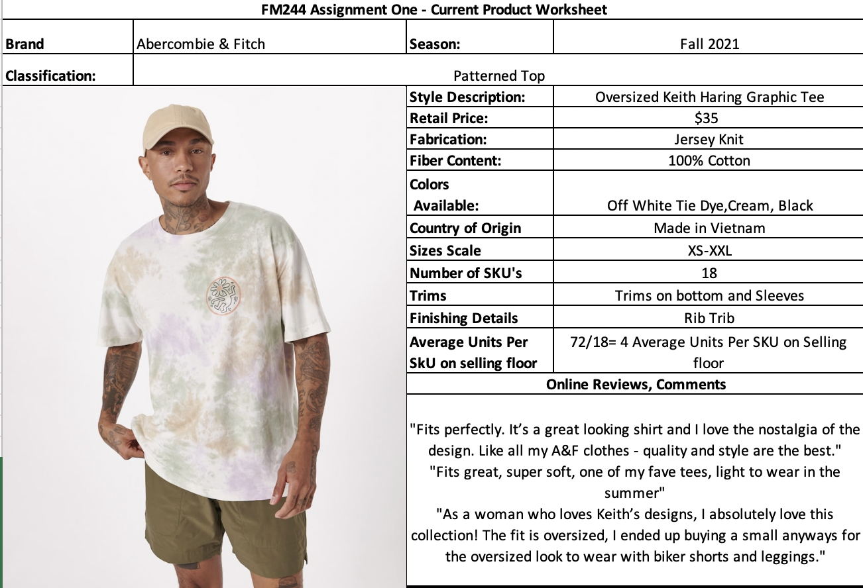

Slide 10
Competition

Slide 11
Competition

Slide 12
High End Lines

Slide 13
Higher End Lines

Slide 14
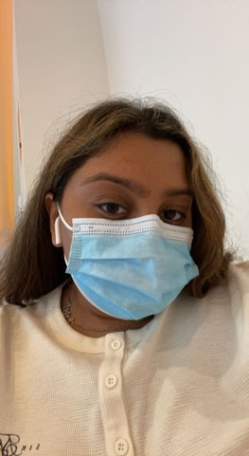
Store Visit
Date of Store Visit: September 23,2021
Willowbrook Mall Location
Wayne, NJ

Slide 15
References
Abercrombie & Fitch. (2021). [Photograph]. https://sourcingjournal.com/denim/denim-brands/abercrombie-fitch-reborn-eg-96767/
Abercrombie & Fitch Gets a Makeover With a New Inclusive Ad Campaign. (2016). [Photograph]. https://www.thefashionspot.com/buzz-news/latest-news/705621-abercrombie-fitch-fall-2016-ad-campaign/
Abercrombie Purpose. (2021). Abercrombie Purpose. https://www.abercrombie.com/shop/eu/about-us?originalStore=us
Abercrombie’s New Store Doesn’t Look (or Smell) Like the Abercrombie You Know. (2017). [Photograph]. https://www.google.com/url?sa=i&url=https%3A%2F%2Fwww.racked.com%2F2017%2F2%2F6%2F14522282%2Fabercrombie-new-look-stores&psig=AOvVaw0cIOBWEdAD4qJvU1hTYpxh&ust=1632930360583000&source=images&cd=vfe&ved=0CAsQjRxqFwoTCPi38eKBovMCFQAAAAAdAAAAABAF
Authentic SUPIMA® T-Shirt. (2021). [Photograph]. https://bananarepublic.gap.com/browse/product.do?pid=744185012&cid=1100817&pcid=80117&vid=1&nav=meganav%3AMen%3AMen%27s+Clothing%3Athe+tee+shop#pdp-page-content
Authentic SUPIMA® V-Neck T-Shirt. (2021). [Photograph]. https://bananarepublic.gap.com/browse/product.do?pid=266422052&pcid=999&vid=1&&searchText=supima#pdp-page-content
Balenciaga. (2021). [Photograph]. https://fashionista.com/.image/t_share/MTUwMzI1ODQxMjQ1NTEzMTkw/balenciaga-new-logo.png
The bizarre history of Abercrombie & Fitch — and how the retailer is transforming yet again. (2016, March 1). Business Insider. https://www.businessinsider.com/abercrombie-fitch-crazy-history-2011-4?international=true&r=US&IR=T#the-retailer-hit-some-road-bumps-along-the-way-3
Cotton T-shirt with multi-color print and PVC covering. (2021). [Photograph]. https://us.dolcegabbana.com/en/men/clothing/t-shirts-and-polos/cotton-t-shirt-with-multi-color-print-and-pvc-covering-multicolor-G8NP0THU7ILHJ3FN.html
Cotton T-shirt with pearl pendant and DG logo. (2021). [Photograph]. https://us.dolcegabbana.com/en/men/clothing/t-shirts-and-polos/cotton-t-shirt-with-pearl-pendant-and-dg-logo-black-G8NC5ZG7A2FN0000.html

Slide 16
References (continued)
Cotton T-shirt with rubberized Dolce&Gabbana logo. (2021). [Photograph]. https://us.dolcegabbana.com/en/men/clothing/t-shirts-and-polos/cotton-t-shirt-with-rubberized-dolceandgabbana-logo-multicolor-G8NB7THU7ILHBSNQ.html
David Thomas Abercrombie. (2018). [Photograph]. https://www.geni.com/people/David-Abercrombie/6000000019857459904
DESTROYED FLATGROUND T-SHIRT IN BLACK. (2021). [Photograph]. https://www.balenciaga.com/en-us/destroyed-flatground-t-shirt-black-651795TKVB81070.html
Dolce & Gabbana. (2021). [Photograph]. https://logos-world.net/wp-content/uploads/2020/12/Dolce-Gabbana-Logo.png
Ezra Fitch. (2018). [Photograph]. https://en.wikipedia.org/wiki/Ezra_Fitch#/media/File:Ezra_Hasbrouck_Fitch.jpg
FREE WIDE FIT T-SHIRT IN BLACK. (2021). [Photograph]. https://www.balenciaga.com/en-us/free-wide-fit-t-shirt-black-661715TKVD31070.html
Horowitz, F. (2021). Diversity & Inclusion. Abercrombie Corporate. https://corporate.abercrombie.com/af-cares/diversity
Media Glamour. (2018). [Photograph]. https://media.glamour.com/photos/5695955493ef4b09520d35cf/16:9/w_1280,c_limit/fashion-2015-05-abercrombie-fitch-models-2015-main.jpg
MEN’S SPORTY B TRACKSUIT T-SHIRT IN BLACK. (2021). [Photograph]. https://www.balenciaga.com/en-us/sporty-b-tracksuit-t-shirt-black-675306TLVA21150.html
Monkey Time Bias Waffle Knit Tee. (2021). [Photograph]. https://www.urbanoutfitters.com/shop/monkey-time-bias-waffle-knit-tee?category=SEARCHRESULTS&color=024&searchparams=department%3DMen%26q%3Dknit%2520tops&type=REGULAR&quantity=1
OBEY Berto Thermal Long Sleeve Tee. (2021). [Photograph]. https://www.urbanoutfitters.com/shop/obey-berto-thermal-long-sleeve-tee?category=SEARCHRESULTS&color=000&searchparams=department%3DMen%26q%3Dknit%2520tops&type=REGULAR&quantity=1
Singh, P. (2021, September 6). Abrcrombie & Fitch names Michael Lopez as senior vice president, ESG. FashionUnited. https://fashionunited.com/news/people/abrcrombie-fitch-names-michael-lopez-as-senior-vice-president-esg/2021083141838
Slim-Fit Tech-Stretch Cotton Shirt. (2021). [Photograph]. https://bananarepublic.gap.com/browse/product.do?pid=707432042&pcid=999&vid=1&searchText=SUPIMA#pdp-page-content
Standard Cloth Weekend Waffle Knit Long Sleeve Tee. (2021). [Photograph]. https://www.urbanoutfitters.com/shop/standard-cloth-weekend-waffle-knit-long-sleeve-tee?category=SEARCHRESULTS&color=001&searchparams=department%3DMen%26q%3Dknit%2520tops&type=REGULAR&quantity=1

Slide 17
Assignment #2 Trend Research and Development
Silhouettes

Slide 18
Trend Research Silhouettes
Basic Knit Top

Slide 19
Trend Research Silhouettes
Fashion Knit Top

Slide 20
Trend Research Silhouettes
Pattern Knit Top

Slide 21
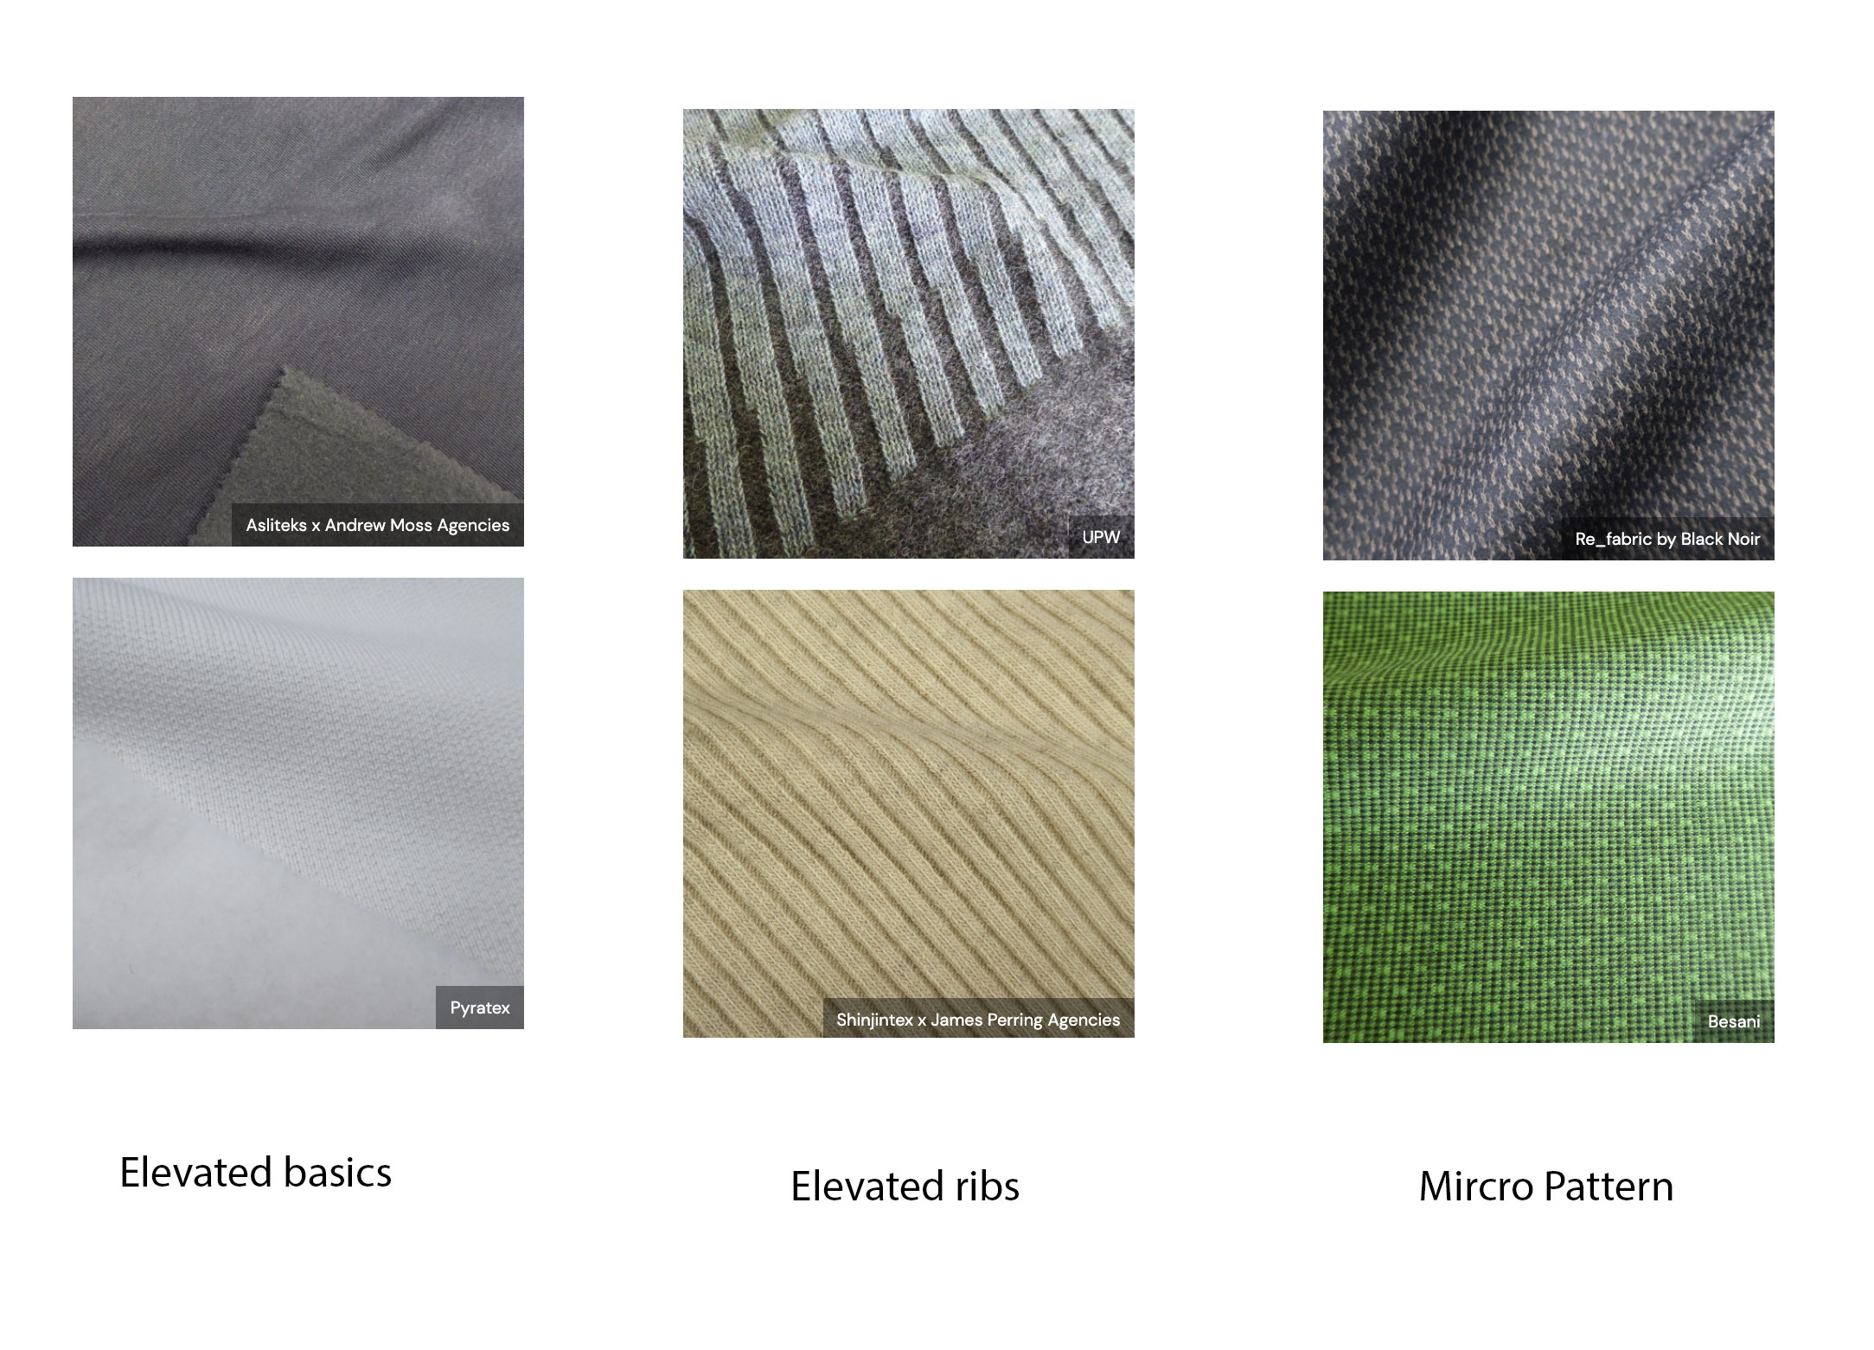
Trend Research : Fabrics
WGSN Article

Slide 22
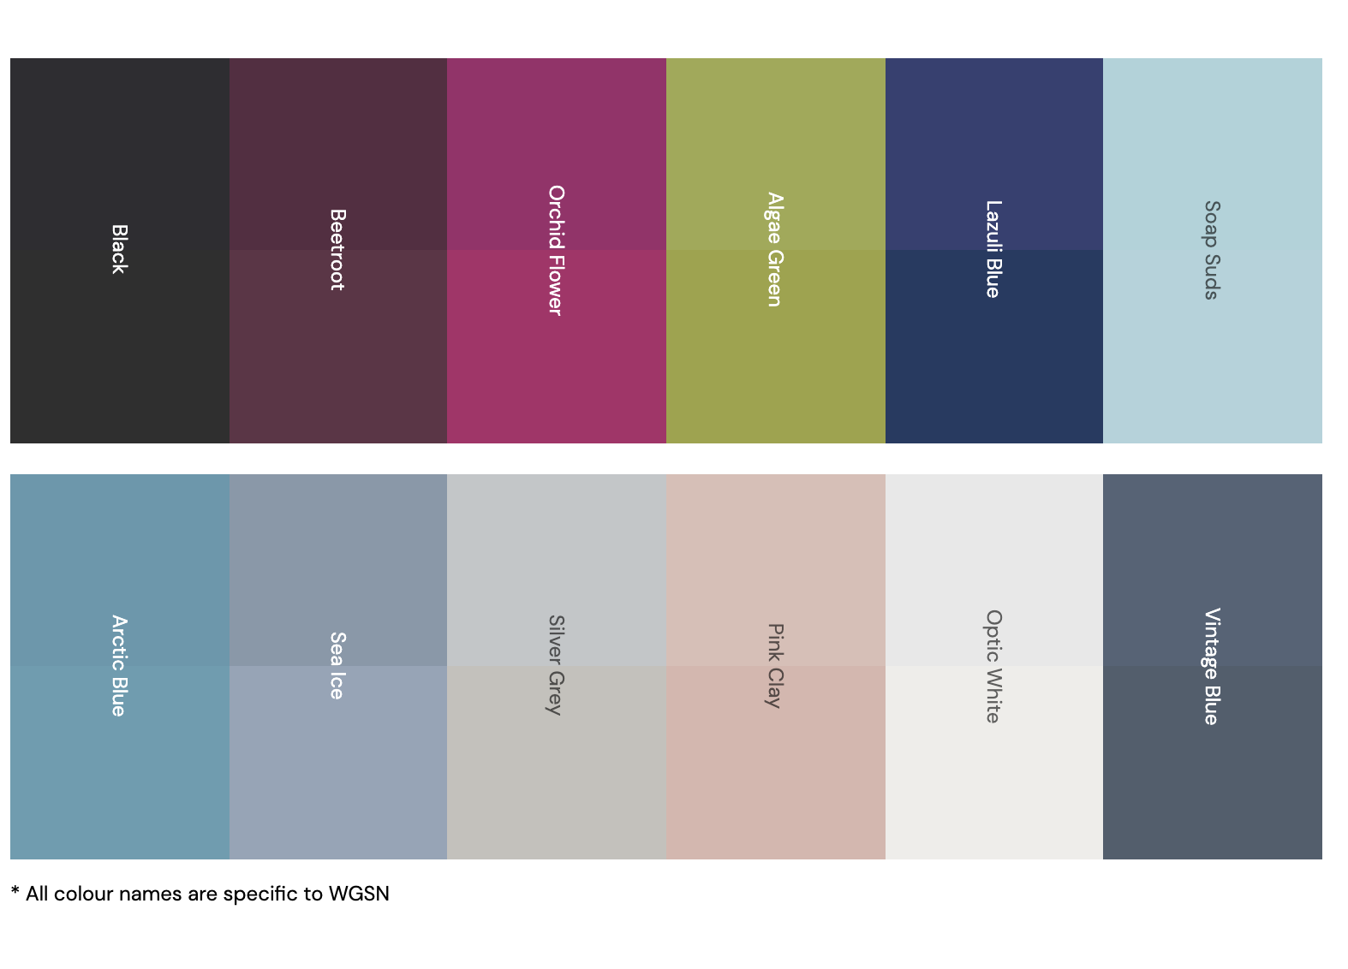
Trend Research : Color Palette
According to WGSN, the color palette is focused on the future of the digital world.

Slide 23
Basic Knit Top

Slide 24
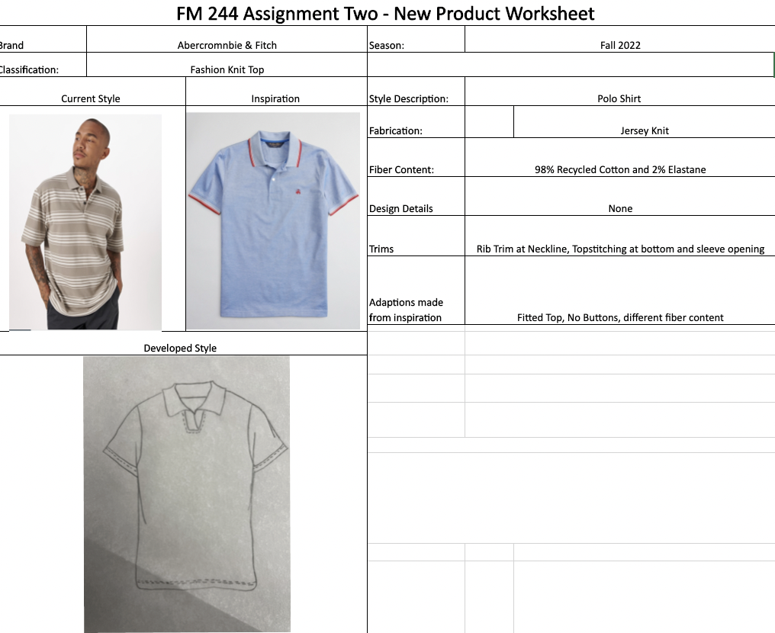
Fashion Knit Top

Slide 25
Pattern Knit Top

Slide 26
References
Core Item Update: Men’s Cut & Sew A/W 22/23. WGSN login. (2021, April 29). Retrieved October 18, 2021, from https://www.wgsn.com/fashion/article/90834?show=image.34350744#page5.
Graphic Library. Fashion Snoops. (n.d.). Retrieved October 18, 2021, from https://www-fashionsnoops-com.libproxy.fitsuny.edu/SearchGraphics.aspx.
Men's Black Cotton T-Shirt With 'Artist Stripe' Trim. Paulsmith.com. (n.d.). Retrieved October 18, 2021, from https://www.paulsmith.com/uk/men-s-black-cotton-t-shirt-with-artist-stripe-webbing.
Men's Must - Haves Fall/Winter 22/23. Fashion Snoops. (2021). Retrieved October 18, 2021, from https://www-fashionsnoops-com.libproxy.fitsuny.edu/ReportPage/men/Forecast_NEW/Main/item/season/100-58517-item.
Menswear Forecast A/W 22/23: Awestruck. WGSN login. (2021, February 23). Retrieved October 18, 2021, from https://www.wgsn.com/fashion/article/90258#page1.
Out Of The Rough. TOBETDG. (2021, April 2). Retrieved October 18, 2021, from https://www.tobetdg.com/great-ideas/out-of-the-rough.
Retail Analysis: Men's Autumn 2021. WGSN. (2021, October 12). Retrieved October 18, 2021, from https://www-wgsn-com.libproxy.fitsuny.edu/fashion/article/92017.
Seeing Green. TOBETDG. (2021, July 29). Retrieved October 18, 2021, from https://www.tobetdg.com/great-ideas/seeing-green.
Slim fit tipped Polo Shirt. Brooks Brothers. (n.d.). Retrieved October 18, 2021, from https://www.brooksbrothers.com/Slim-Fit-Tipped-Polo-Shirt/MP01306_____XBL1_MED______,default,pd.html?src=googleshopping&cmp=ppc_us_gg_DR_PLA_ML_438767199546_100603230703_2446200196&gclid=CjwKCAjwk6-LBhBZEiwAOUUDp6lvH3Bx7K5hnWc8Df9UI8JPWLOcvkfGN_L4e1xOOBb1fBuAiHKJdhoCXN0QAvD_BwE.
Textile Sourcing Guide: Men's Knitwear & Jersey A/W 22/23. WGSN login. (2021, September 10). Retrieved October 18, 2021, from https://www.wgsn.com/fashion/article/91838.
Twin tipped Polo Shirt. Twin Tipped Polo Shirt - Snow White | Made in Japan Collection | Polos & Outerwear, J-Quality Certified | Fred Perry UK. (n.d.). Retrieved October 18, 2021, from https://www.fredperry.com/men/polo-shirts/twin-tipped-polo-shirt-m102-129.html.

Slide 27
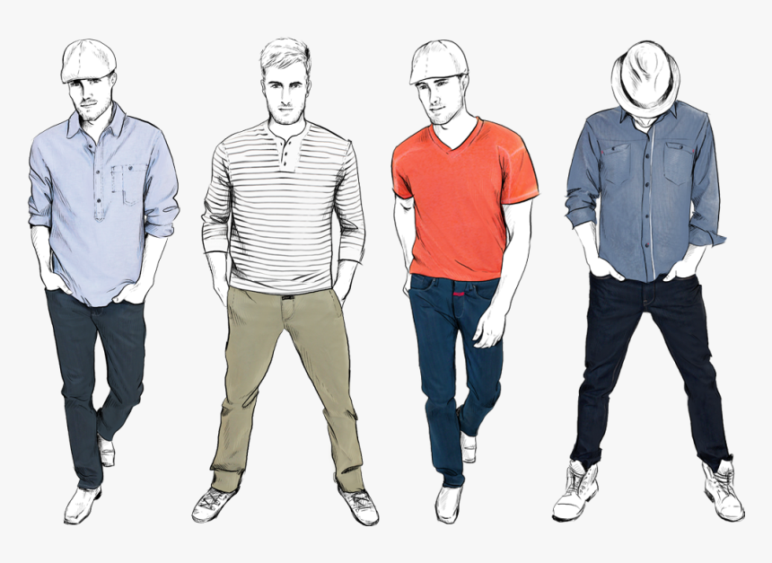
Assignment #3
Color, Print, Pattern and Specs

Slide 28
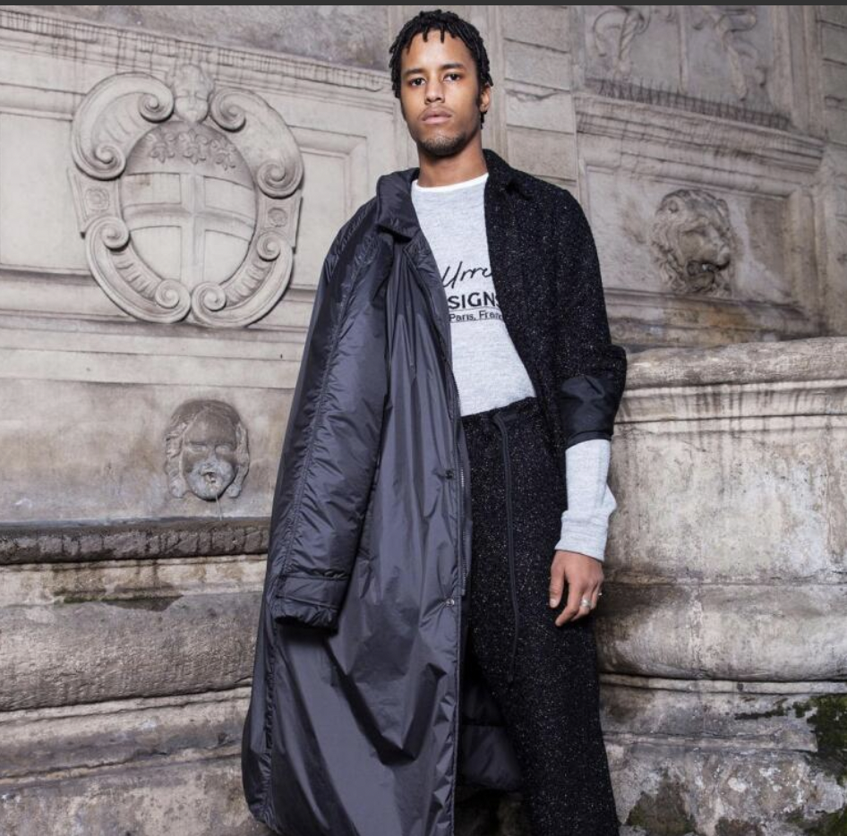
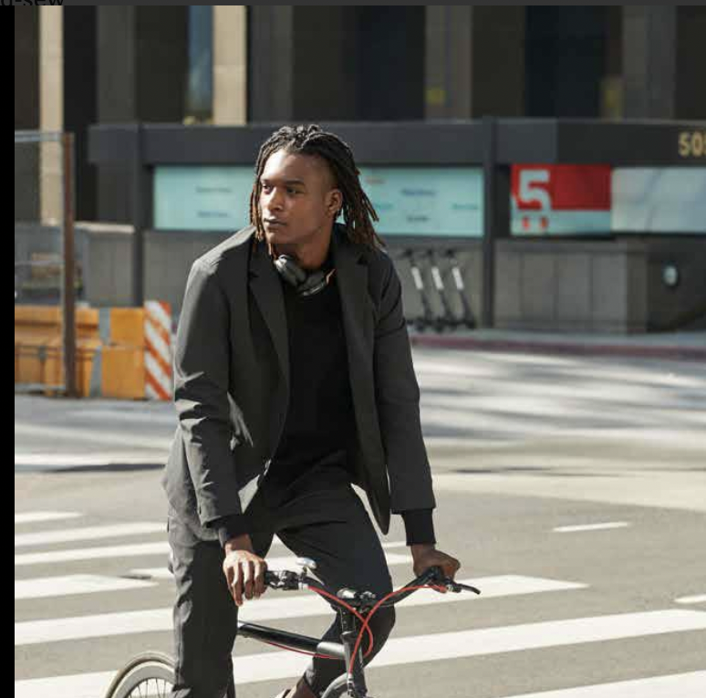
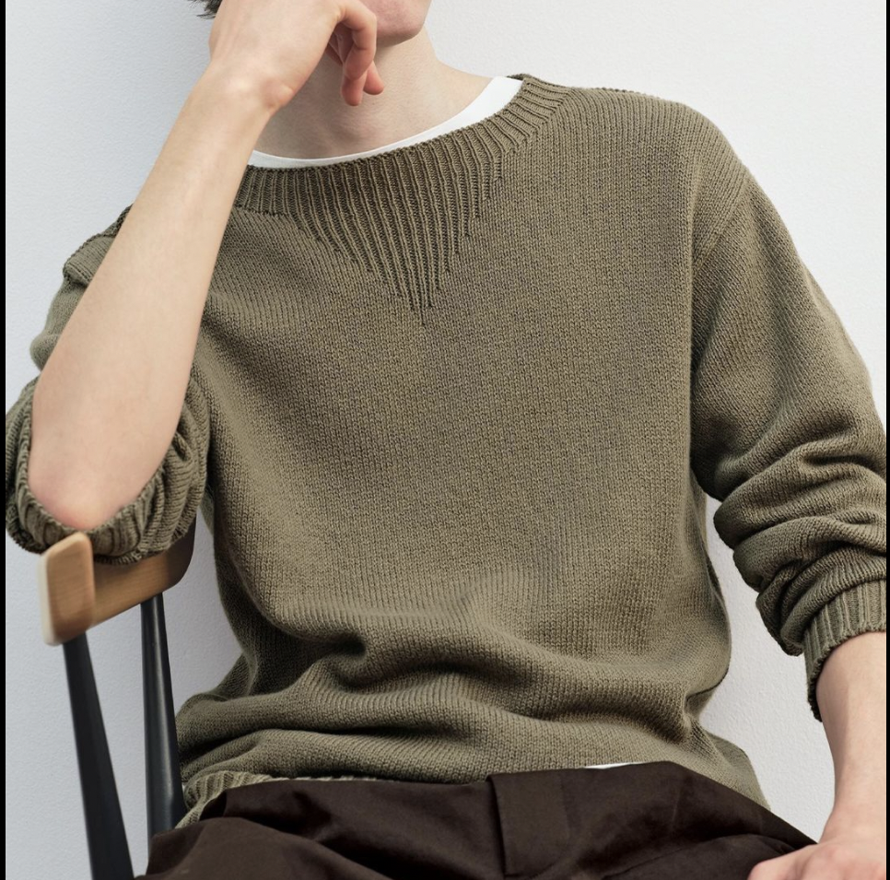
Worklesiure
Takes elements of loungwear with professional attire

Slide 29
Worklesiure – Fall 2022 Color Palette
Neutral Colors
Fashion Colors

Slide 30
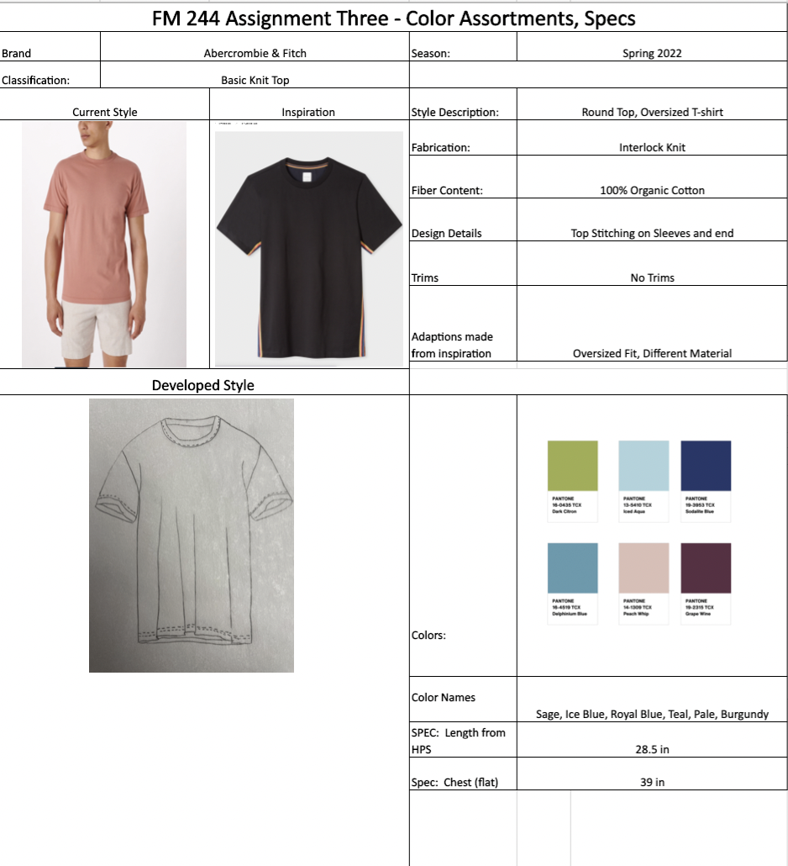

Slide 31
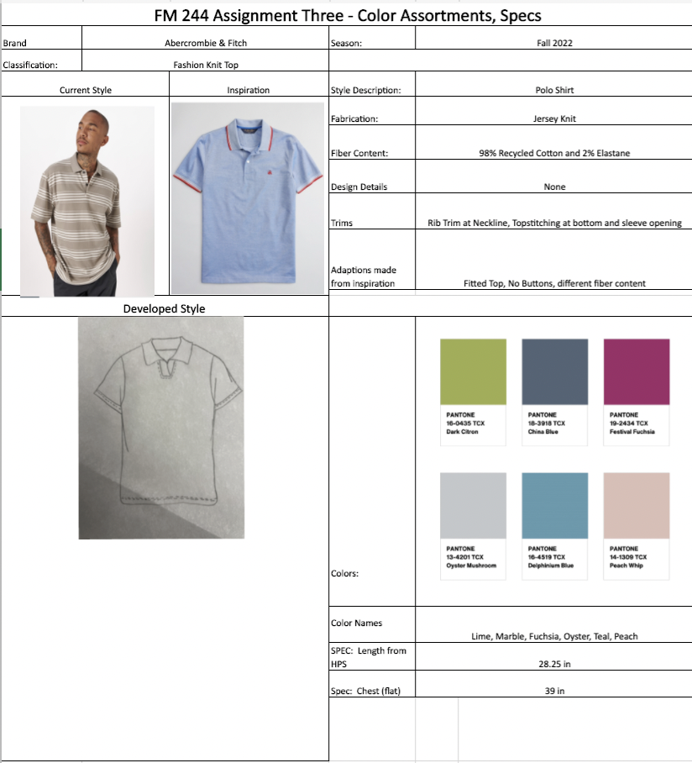

Slide 32
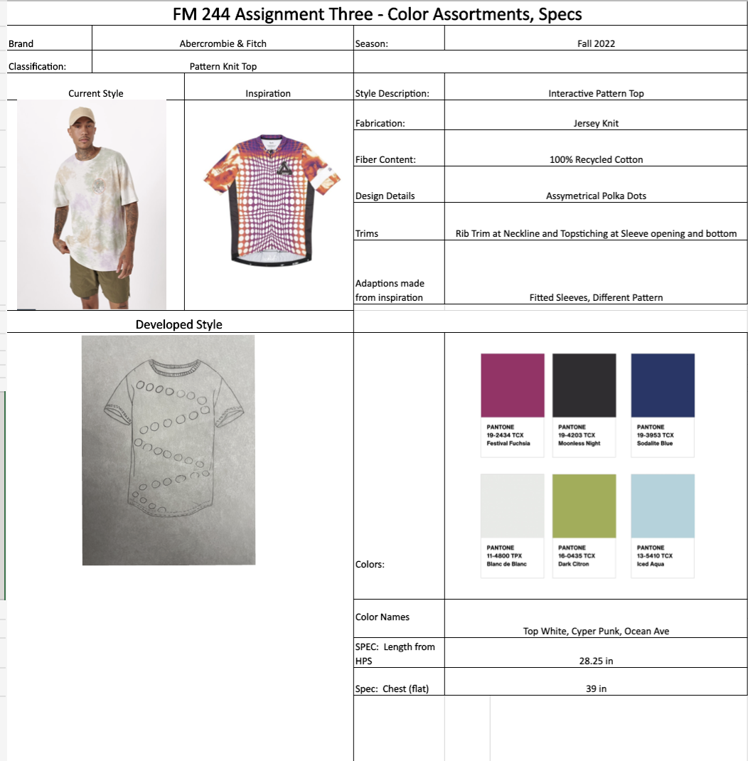

Slide 34
References
#consideredcommute #workleisure #smartenup. Library Wide | Fashion Institute of Technology. (n.d.). Retrieved November 15, 2021, from https://www-wgsn-com.libproxy.fitsuny.edu/fashion/feed?filters=%7B%22markets%22%3A%5B%2212%22%2C%2297%22%5D%2C%22hashtags%22%3A%5B%22workleisure%22%5D%7D&show=60241ba17ace587cadadf2a4.
#elevatedbasics #collectionessentials #workleisure. Library Wide | Fashion Institute of Technology. (n.d.). Retrieved November 15, 2021, from https://www-wgsn-com.libproxy.fitsuny.edu/fashion/feed?filters=%7B%22markets%22%3A%5B%2212%22%2C%2297%22%5D%2C%22hashtags%22%3A%5B%22workleisure%22%5D%7D&show=607425fb76abd5004686c40f.
Brands to Watch S/S 21 Menswear . Library Wide | Fashion Institute of Technology. (n.d.). Retrieved November 15, 2021, from https://www-wgsn-com.libproxy.fitsuny.edu/fashion/article/90413?show=image.34276729.
Brands to Watch S/S 21: Menswear. Library Wide | Fashion Institute of Technology. (n.d.). Retrieved November 15, 2021, from https://www-wgsn-com.libproxy.fitsuny.edu/fashion/article/90413#page3.
Men S fashion shoes clipart, character design, mens - mens fashion clipart PNG, transparent PNG , transparent PNG image - pngitem. PNGitem.com. (n.d.). Retrieved November 15, 2021, from https://www.pngitem.com/middle/hTRRhhm_men-s-fashion-shoes-clipart-character-design-mens/.
Men's, Young Men's, #workleisure. Library Wide | Fashion Institute of Technology. (n.d.). Retrieved November 15, 2021, from https://www-wgsn-com.libproxy.fitsuny.edu/fashion/feed?filters=%7B%22markets%22%3A%5B%2212%22%2C%2297%22%5D%2C%22hashtags%22%3A%5B%22workleisure%22%5D%7D.
Menswear Forecast A/W 22/23: Awestruck. WGSN login. (n.d.). Retrieved November 15, 2021, from https://www.wgsn.com/fashion/article/90258#page2.
Pantone. (n.d.). Pantone® 11-4800 TPX Blanc de Blanc - find a pantone color: Quick Online Color Tool: PANTONE APAC. Pantone Color, Chips & Color Guides. Retrieved November 15, 2021, from https://www.pantone.com/hk/en/connect/11-4800-TPX?gclid=CjwKCAiAp8iMBhAqEiwAJb94z7PgcGi1WwfJUQzlDWmdC_Z55vvaUEZGLVKl_Ag_UV3GBvmdzZYdJxoC4VoQAvD_BwE.
Pantone. (n.d.). Pantone® 13-4201 TCX oyster mushroom - find a pantone color: Quick Online Color Tool: Pantone. Pantone Color, Chips & Color Guides. Retrieved November 15, 2021, from https://www.pantone.com/connect/13-4201-TCX.
Pantone. (n.d.). Pantone® 13-5410 TCX iced aqua - find a pantone color: Quick Online Color Tool: Pantone. Pantone Color, Chips & Color Guides. Retrieved November 15, 2021, from https://www.pantone.com/connect/13-5410-TCX?gclid=CjwKCAiAp8iMBhAqEiwAJb94z6seO6y0jDLQdeGhLBMLf0matuMBI9JbQqeFfZqfULyoSE21_1A3WxoCjUQQAvD_BwE.
Pantone. (n.d.). Pantone® 14-1309 TCX Peach whip - find a pantone color: Quick Online Color Tool: Pantone. Pantone Color, Chips & Color Guides. Retrieved November 15, 2021, from https://www.pantone.com/connect/14-1309-TCX?gclid=CjwKCAiAp8iMBhAqEiwAJb94z4IG6anLFveMhcWn2_ZihoMHVJozyQEq9TaG8-CZb8Z8jgVZF-1OBBoCpLYQAvD_BwE.
Pantone. (n.d.). Pantone® 16-0435 TCX dark citron - find a pantone color: Quick Online Color Tool: Pantone. Pantone Color, Chips & Color Guides. Retrieved November 15, 2021, from https://www.pantone.com/connect/16-0435-TCX.
Pantone. (n.d.). Pantone® 16-4013 TCX Ashley Blue - find a pantone color: Quick Online Color Tool: Pantone. Pantone Color, Chips & Color Guides. Retrieved November 15, 2021, from https://www.pantone.com/connect/16-4013-TCX.
Pantone. (n.d.). Pantone® 16-4519 TCX delphinium blue - find a pantone color: Quick Online Color Tool: Pantone. Pantone Color, Chips & Color Guides. Retrieved November 15, 2021, from https://www.pantone.com/connect/16-4519-TCX.
Pantone. (n.d.). Pantone® 18-3918 TCX China blue - find a pantone color: Quick Online Color Tool: Pantone. Pantone Color, Chips & Color Guides. Retrieved November 15, 2021, from https://www.pantone.com/connect/18-3918-TCX.
Pantone. (n.d.). Pantone® 19-2315 TCX grape wine - find a pantone color: Quick Online Color Tool: Pantone. Pantone Color, Chips & Color Guides. Retrieved November 15, 2021, from https://www.pantone.com/connect/19-2315-TCX?gclid=CjwKCAiAp8iMBhAqEiwAJb94z72k6w2bND7NwvVNQV3_CaAkDfo_uFwRqlsObs4eSuxE8FVuheIsZBoCgi0QAvD_BwE.
Pantone. (n.d.). Pantone® 19-2434 TCX festival fuchsia - find a pantone color: Quick Online Color Tool: Pantone. Pantone Color, Chips & Color Guides. Retrieved November 15, 2021, from https://www.pantone.com/connect/19-2434-TCX.
Pantone. (n.d.). Pantone® 19-3953 TCX sodalite blue - find a pantone color: Quick Online Color Tool: Pantone. Pantone Color, Chips & Color Guides. Retrieved November 15, 2021, from https://www.pantone.com/connect/19-3953-TCX.
Pantone. (n.d.). Pantone® 19-4203 TCX moonless night - find a pantone color: Quick Online Color Tool: Pantone. Pantone Color, Chips & Color Guides. Retrieved November 15, 2021, from https://www.pantone.com/connect/19-4203-TCX.

